Slide 1
Umbdenstock &
Schroeder’s to Lake County
Illinois
1 Feb 2017
© James L. Powers, 2014
For more Information:
jlpowers@earthlink.net
707-738-3903
Reproduction may be made for non-commercial purposes only.
Information herein are solely my opinions and should not be treated as fact.

Slide 2
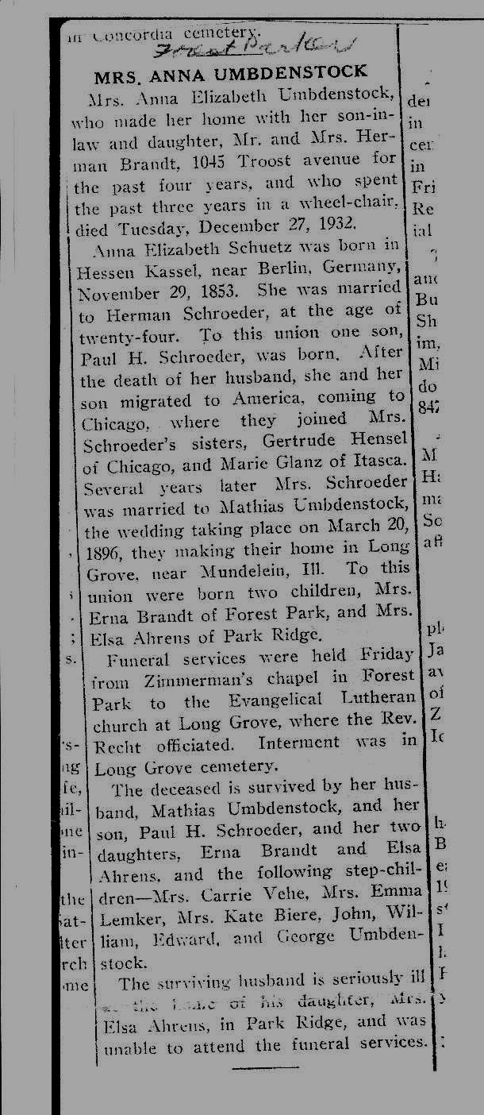
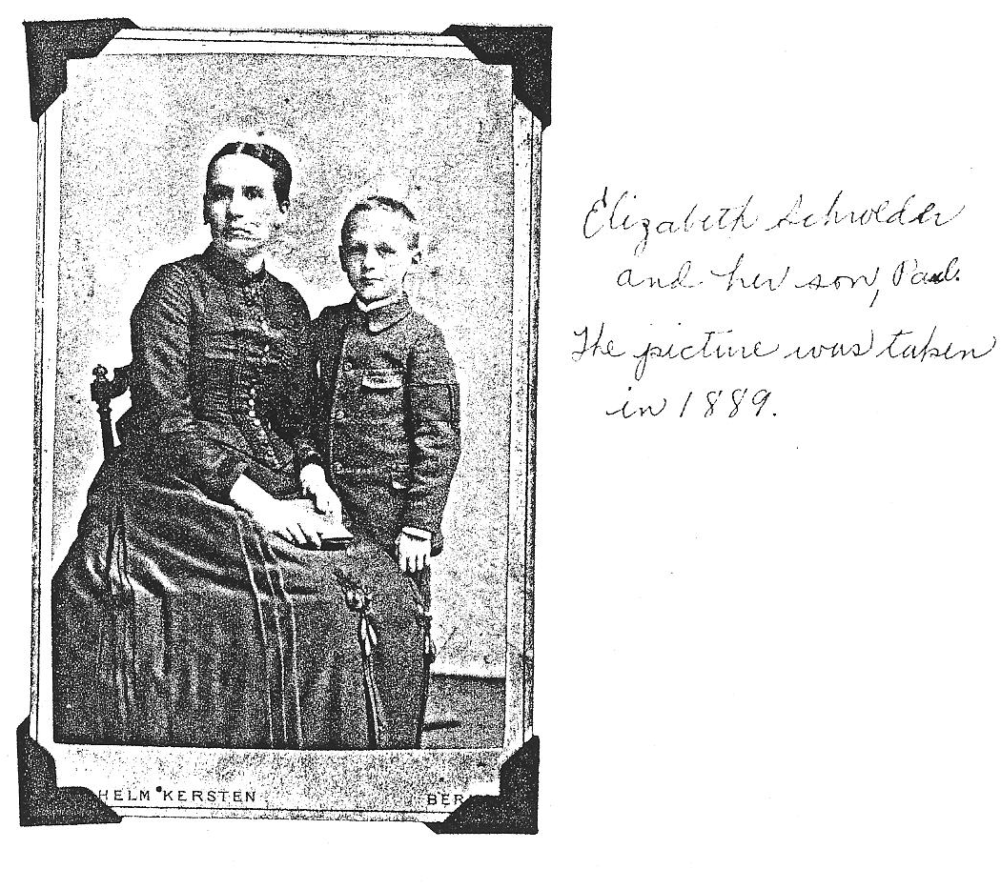
Anna Elizabeth Schroeder’s Obit
29 Nov 1853 - 27 Dec 1933
Notes:
Ancestry.com Parents Wilhelm Schuetz m. Anna M Boerger d. 1862 daughter of Johann H Boerger (BigTree2013) Laurie_Shields
Obit says Anna & Mathias were married 20 March 1896. Best Info is 21 March 1895.

Slide 3
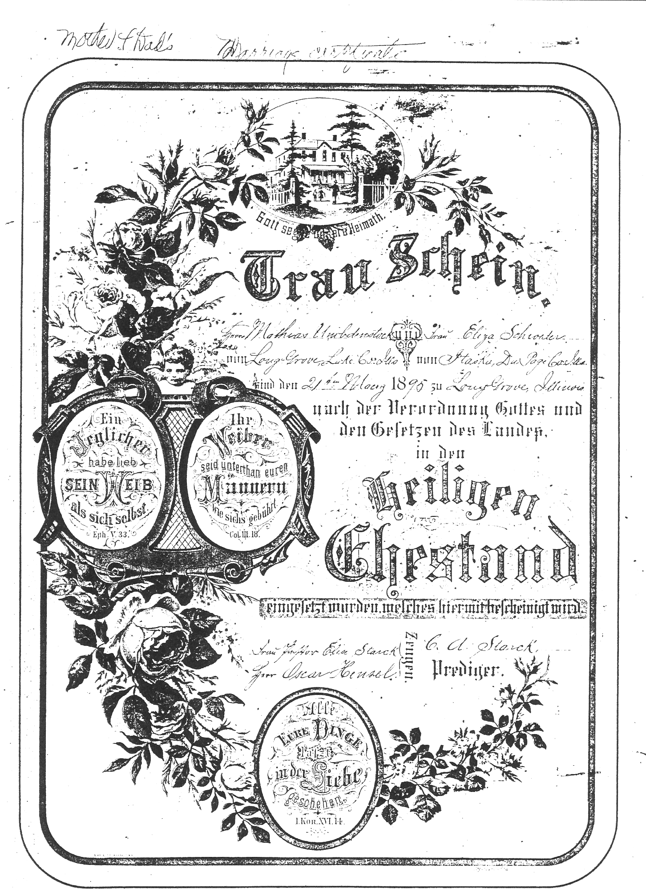
Anna Elisabeth & Mathias Umbdenstock Marriage
Witnesses:
Oscar Hensel
Frau Starck &
Preacher Starck

Slide 4
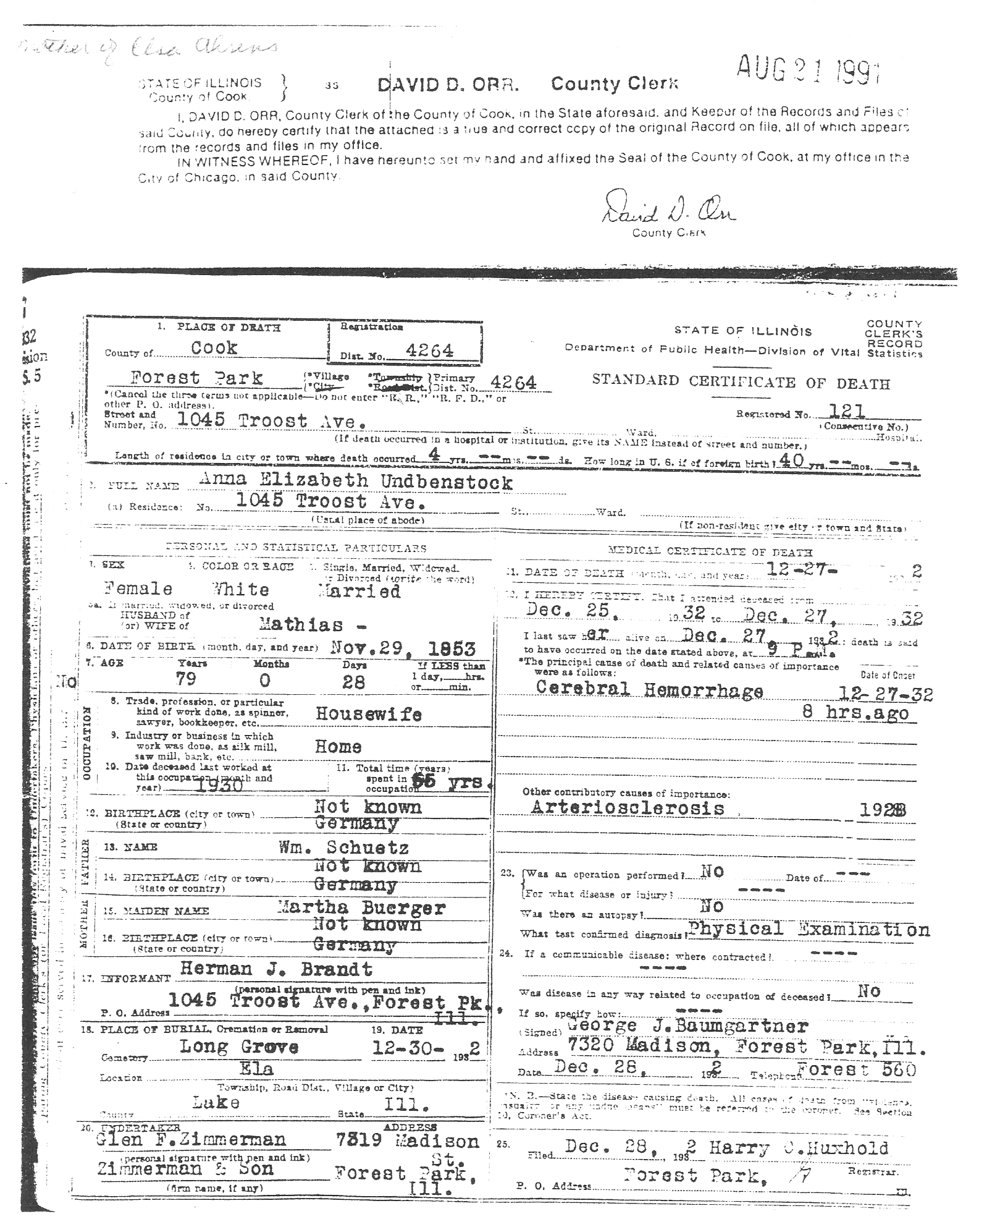
Anna Elizabeth’s Death Certificate
Ancestry.com: Parents -
Wilhelm Schuetz m. Anna Margarethe Boerger d. 1862 daughter of Johann H Boerger (BigTree2013) Laurie_Shields
Notes:
Death Certificate listed as Undbenstock

Slide 5
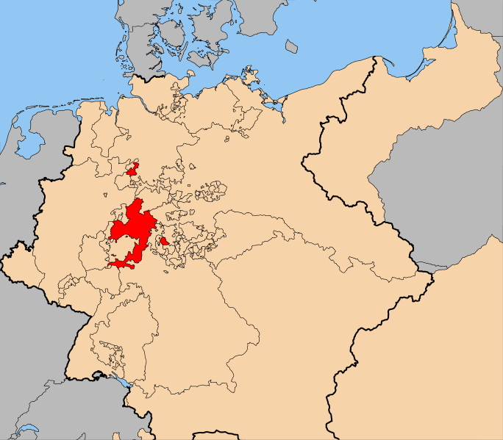
Hesse Kassel

Slide 6
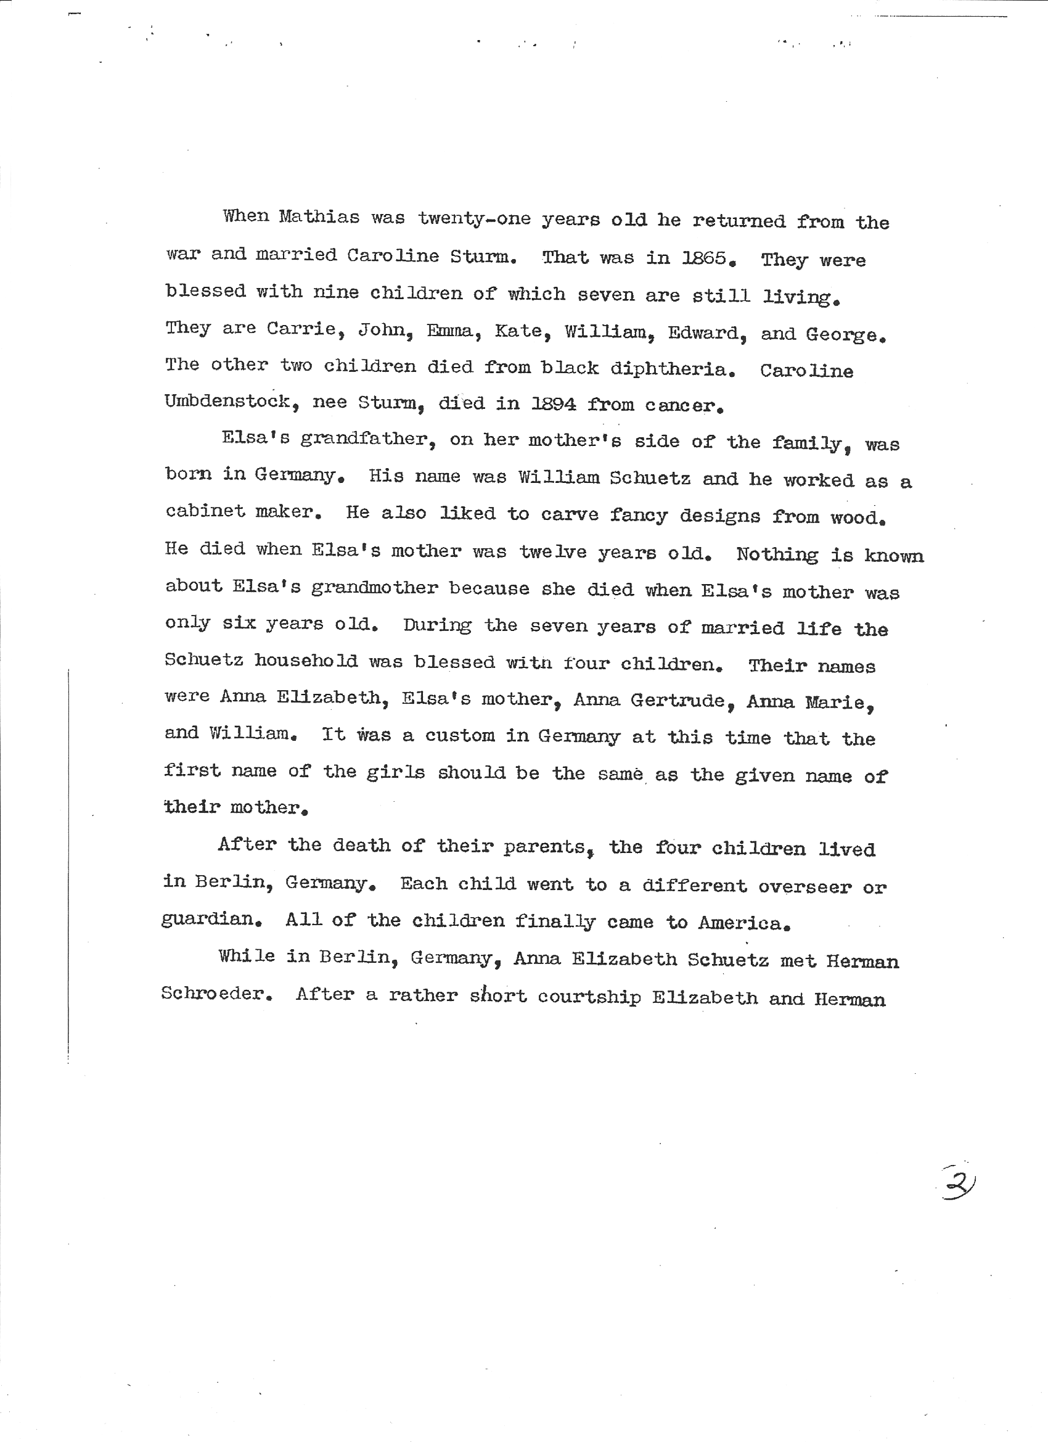
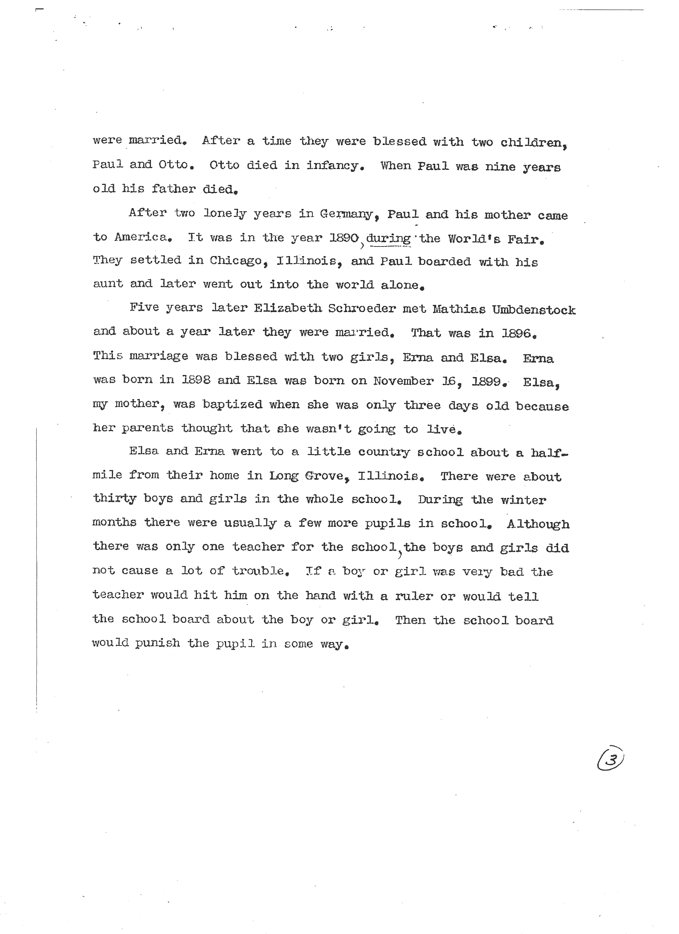
Lorraine’s Paper ca. 1938

Slide 7
Anna Elizabeth Schroeder Family
1. William Schuetz b.? – d. ca.1865?
+ Anna Margarethe Boerger b. ?- d. ca. 1859 Father: Johann Heinrick Boerger b. Wahlershauen, Germany
2. Anna Elizabeth b. 1853-1933 emigrated to US ca. 1892, Lived in Hessen Kassel
+Herman Schroeder b.?-d. 1889?
3. Otto Schroeder b.1877-d.1877 Memorial Picture at Laurie’s house
3. Paul Schroeder b.1880-d. 1969 Lived at 169 Washtenaw, Chicago, IL , 1900 census
+ Louise Wiedman b. 1878?-d.1969 Born in Iowa; Carrie Wiedman Mother
++Mathias Umbdenstock b. 1843 –d. 1933 Anna lived in Itasca before she married Mathias in 1896
3. Erna Umdenstock b. 1898-d.
+Herman Brandt
3. Elsa Umbdenstock b. 1899-d.1998
+Louis Ahrens
2. Anna Gertrude b. 1856- Lived at 169 Washtenaw, Chicago, IL ca. 1900
+ Oscar Hensel b. 1856- Witnessed Mathias & Elizabeth Marriage
3. Max Hensel b. 1882 - ? B. Moabit, Berlin
3. George Hensel b. 1887 - ?
3. Harry Hensel b. 1889 - 1955 Witnessed Louis & Elsa’s marriage, no wife no children
2. Anna Maria b. 1859 - ? Lived in Addison Twp near Itasca, Il, 1900 census, Lived I n MI later
+ Charles Glanz b. 1857
3. Lilly Glanz b. 1885
3. Emma b. 1887
3. Anna b. 1888
3. Bertha b. 1892
3. Mary b. 1893
3. Minna b. 1894
3. Charles b. 1896
3. Elizabeth? b. >1900? Witnessed Louis & Elsa’s marriage; Emil Schroeder also witnessed?
2. William Schuetz ? No information, except that he came to America – Lorraine's Paper
Notes:
Wm & Anna Schuetz info from Lorraines Paper.
1. Johann Heinrick Boerger
2. Margarethe Boerger from BIG TREE 2013 laurie_shields b. ?-d. 1862
2. Caspar Boerger b. d. 1884
2. Nickolas Boerger b. 1830-d. 1901

Slide 8
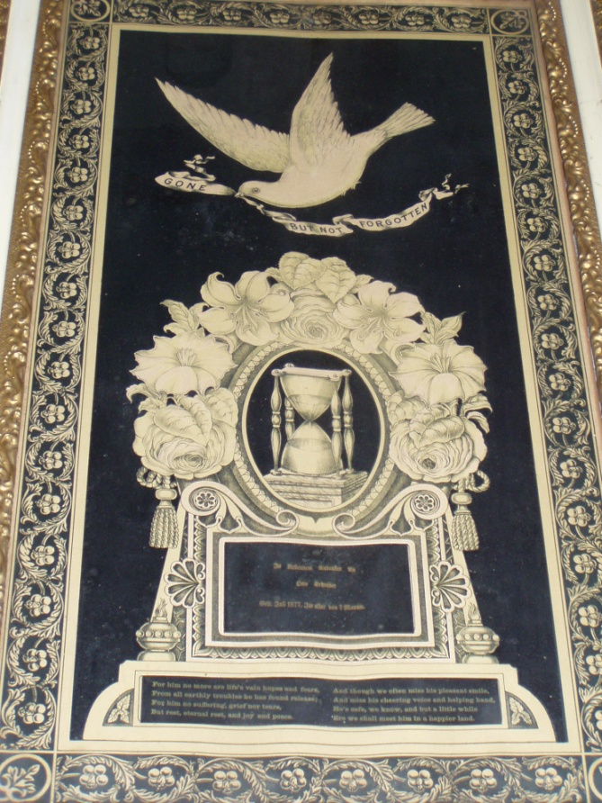
Otto Schroeder’s Memorial

Slide 9
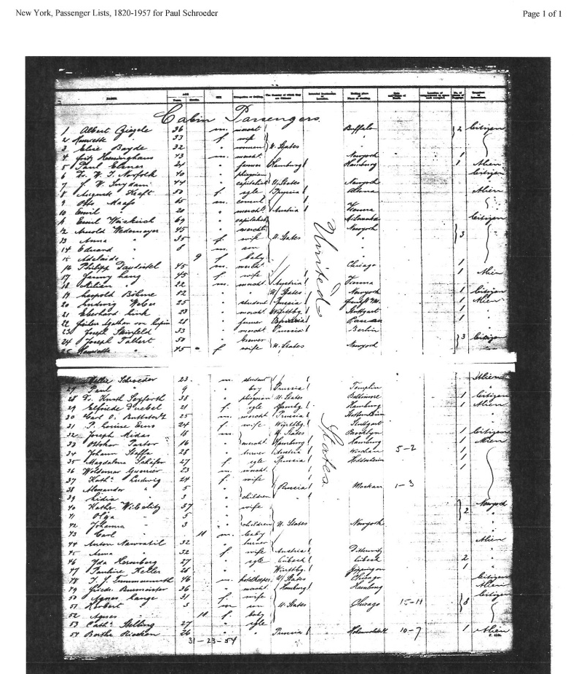
Paul Schroeder’s Emigration
Ship Agusta Victoria Arrival 8 Nov 1890, NY
Notes:
Cannot find Anna Schroeder
Who’s Willie Schroeder age 23?
Paul is 9 y.o.
They are going to Illinois

Slide 10
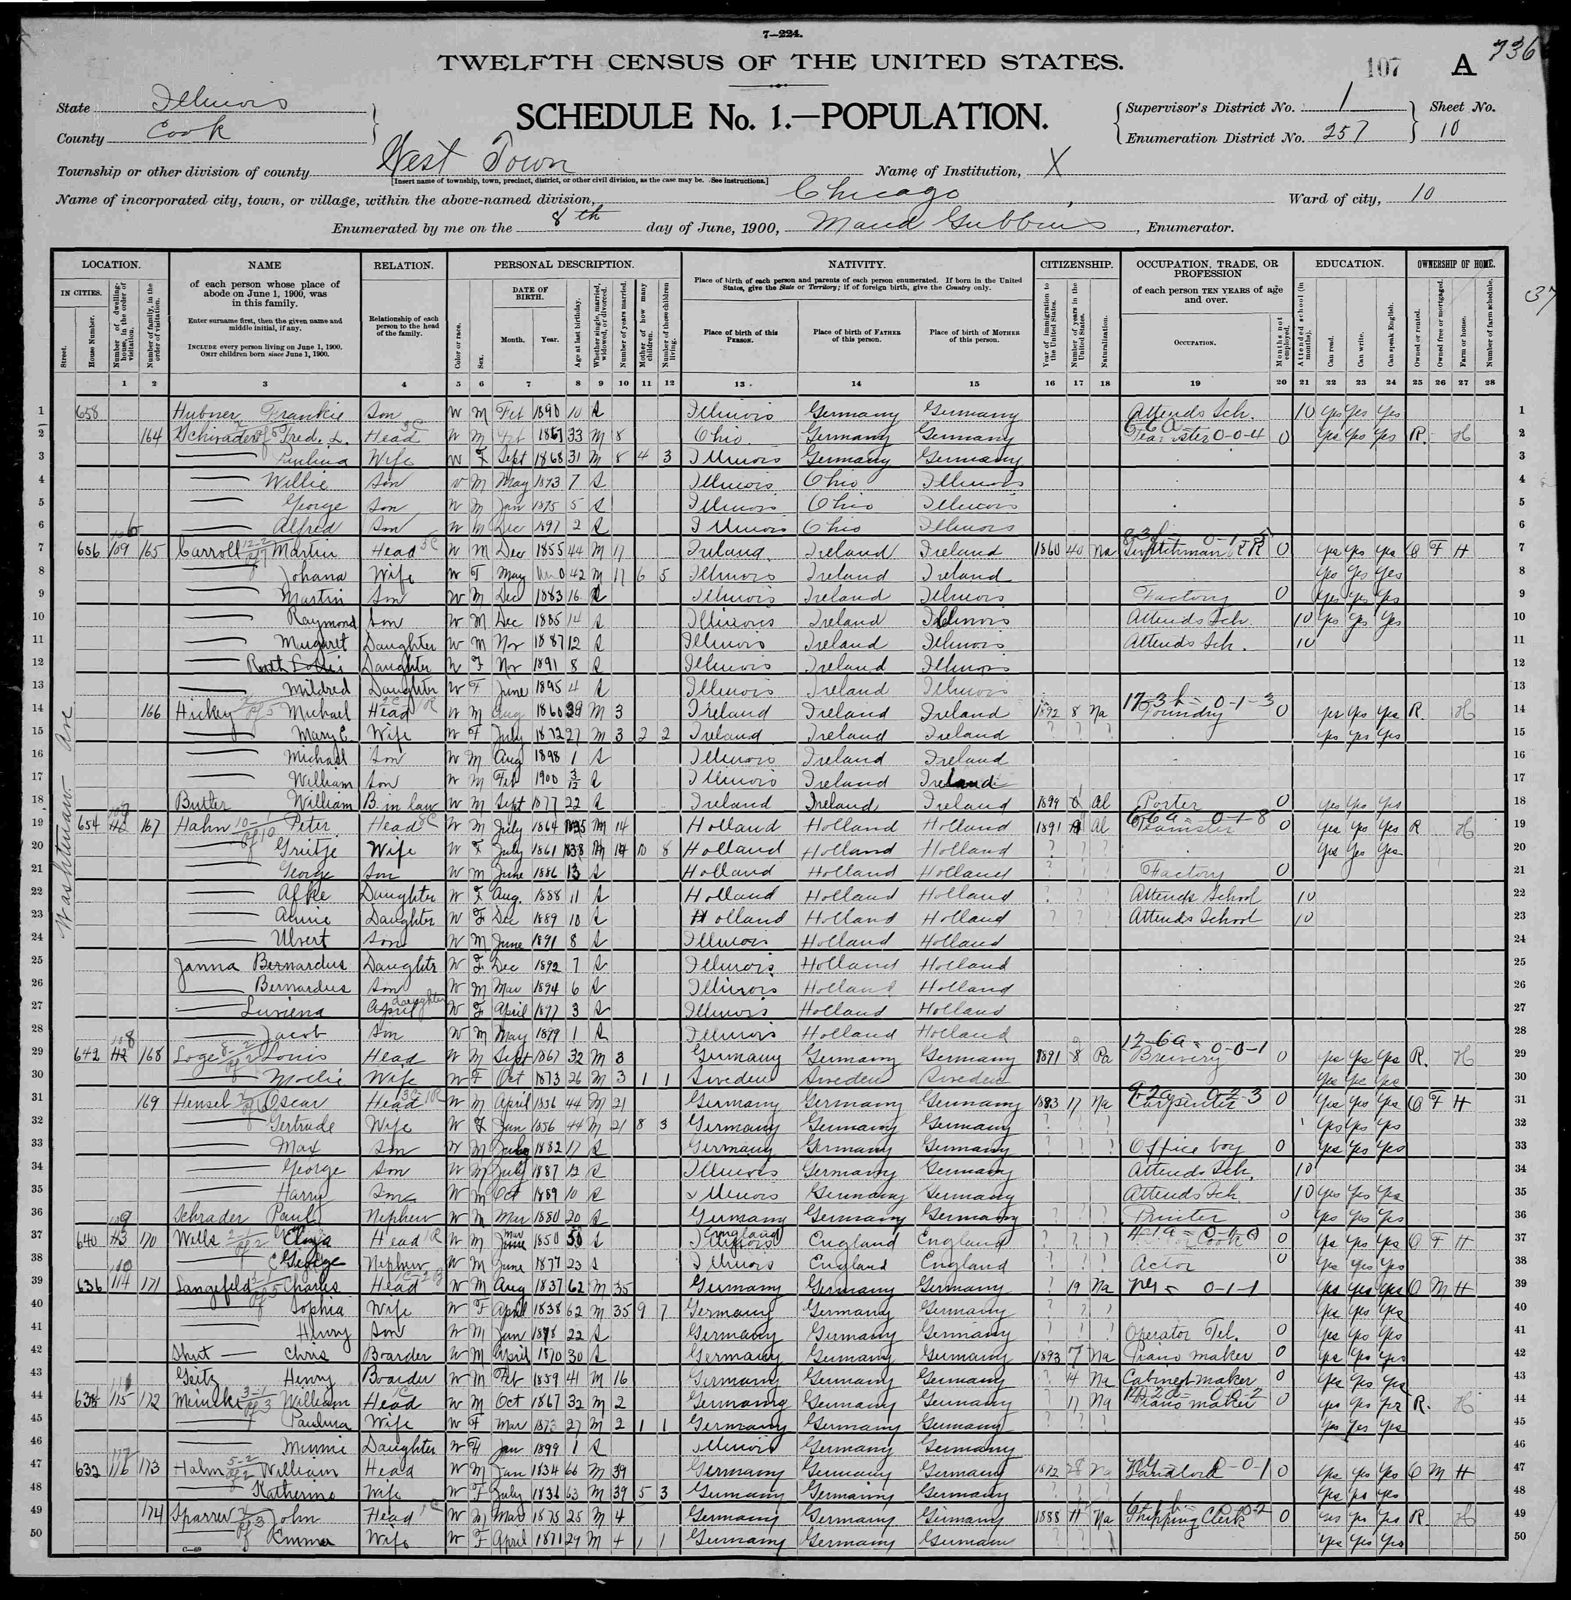
1900 Census Paul Schroeder &
Aunt Anna Gertrude
Notes:
Paul H Schroeder Age: 34 Gender: Male Birth Year: abt 1880 Marriage Type: Marriage Marriage Date: 29 Apr 1914 Marriage Place: Chicago, Cook, Illinois Spouse Name: A Louise C Schroeder Spouse Age: 34 Spouse Gender: Female FHL Film Number: 1030570 Start a Tree with This Person: Paul H Schroeder
Begin your tree with: Paul H Schroeder Save to my shoebox
Save this record for later evaluation and organization or Cancel
Save This Record
Attach this record to a person in your tree as a source record, or save for later evaluation. Save
Source Information:
Ancestry.com. Cook County, Illinois, Marriages Index, 1871-1920 [database on-line]. Provo, UT, USA: Ancestry.com Operations, Inc., 2011.
Original data: “Illinois, Cook County Marriages, 1871–1920.” Index. FamilySearch, Salt Lake City, Utah, 2010. Illinois Department of Public Health records. "Marriage Records, 1871–present." Division of Vital Records, Springfield, Illinois.
Paul Schroeder B. 1880 D. March 7, 1969

Slide 11
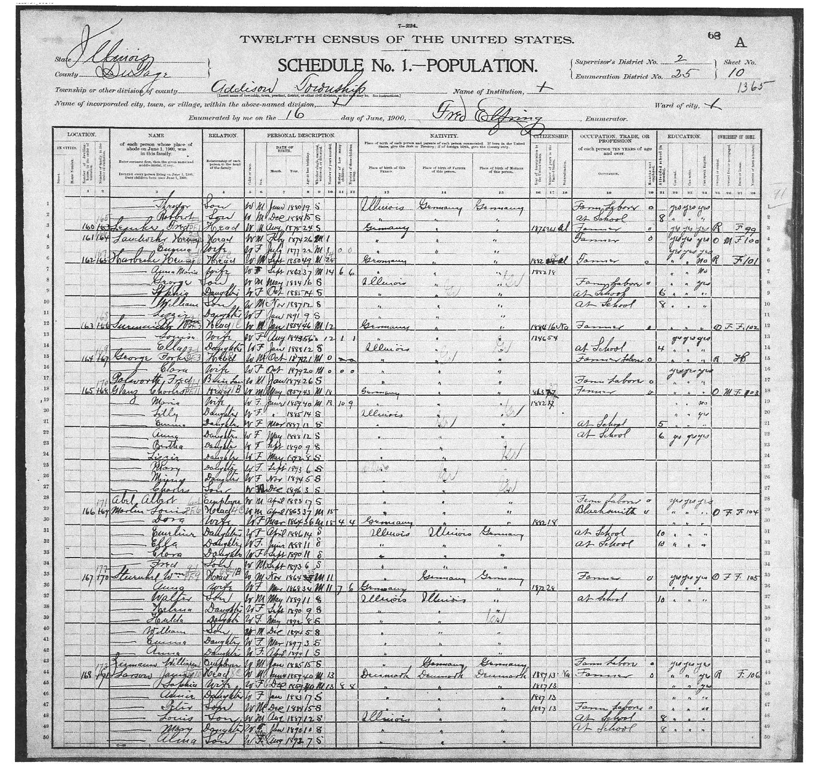
Aunt Anna Maria Glanz
Anna Elizabeth’s Sister

Slide 12
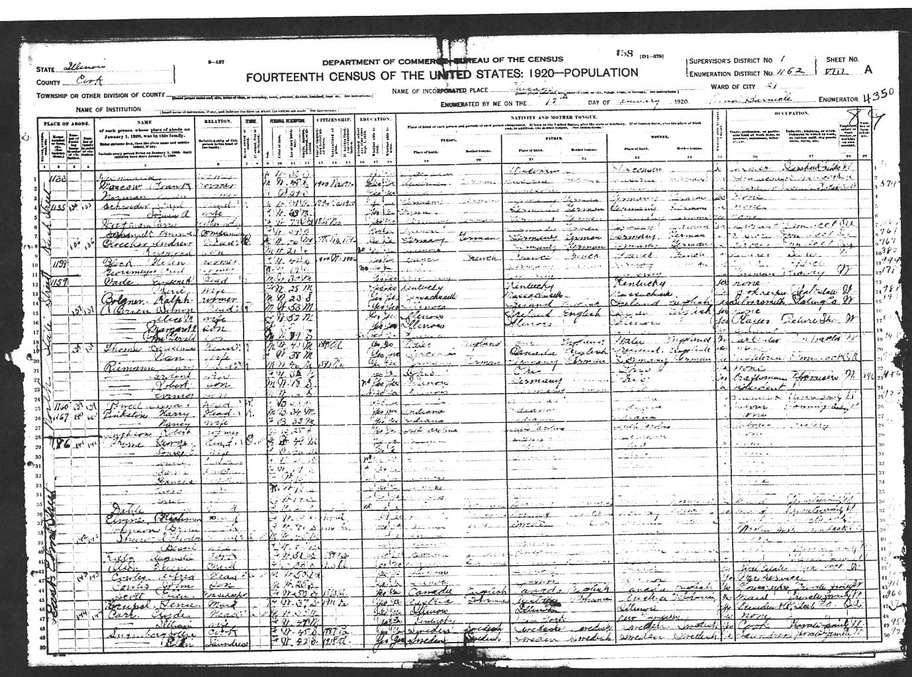
1920 Census Paul & Louise Schroeder
Notes:
Carrie Wiedman, Mother-in-Law

Slide 13
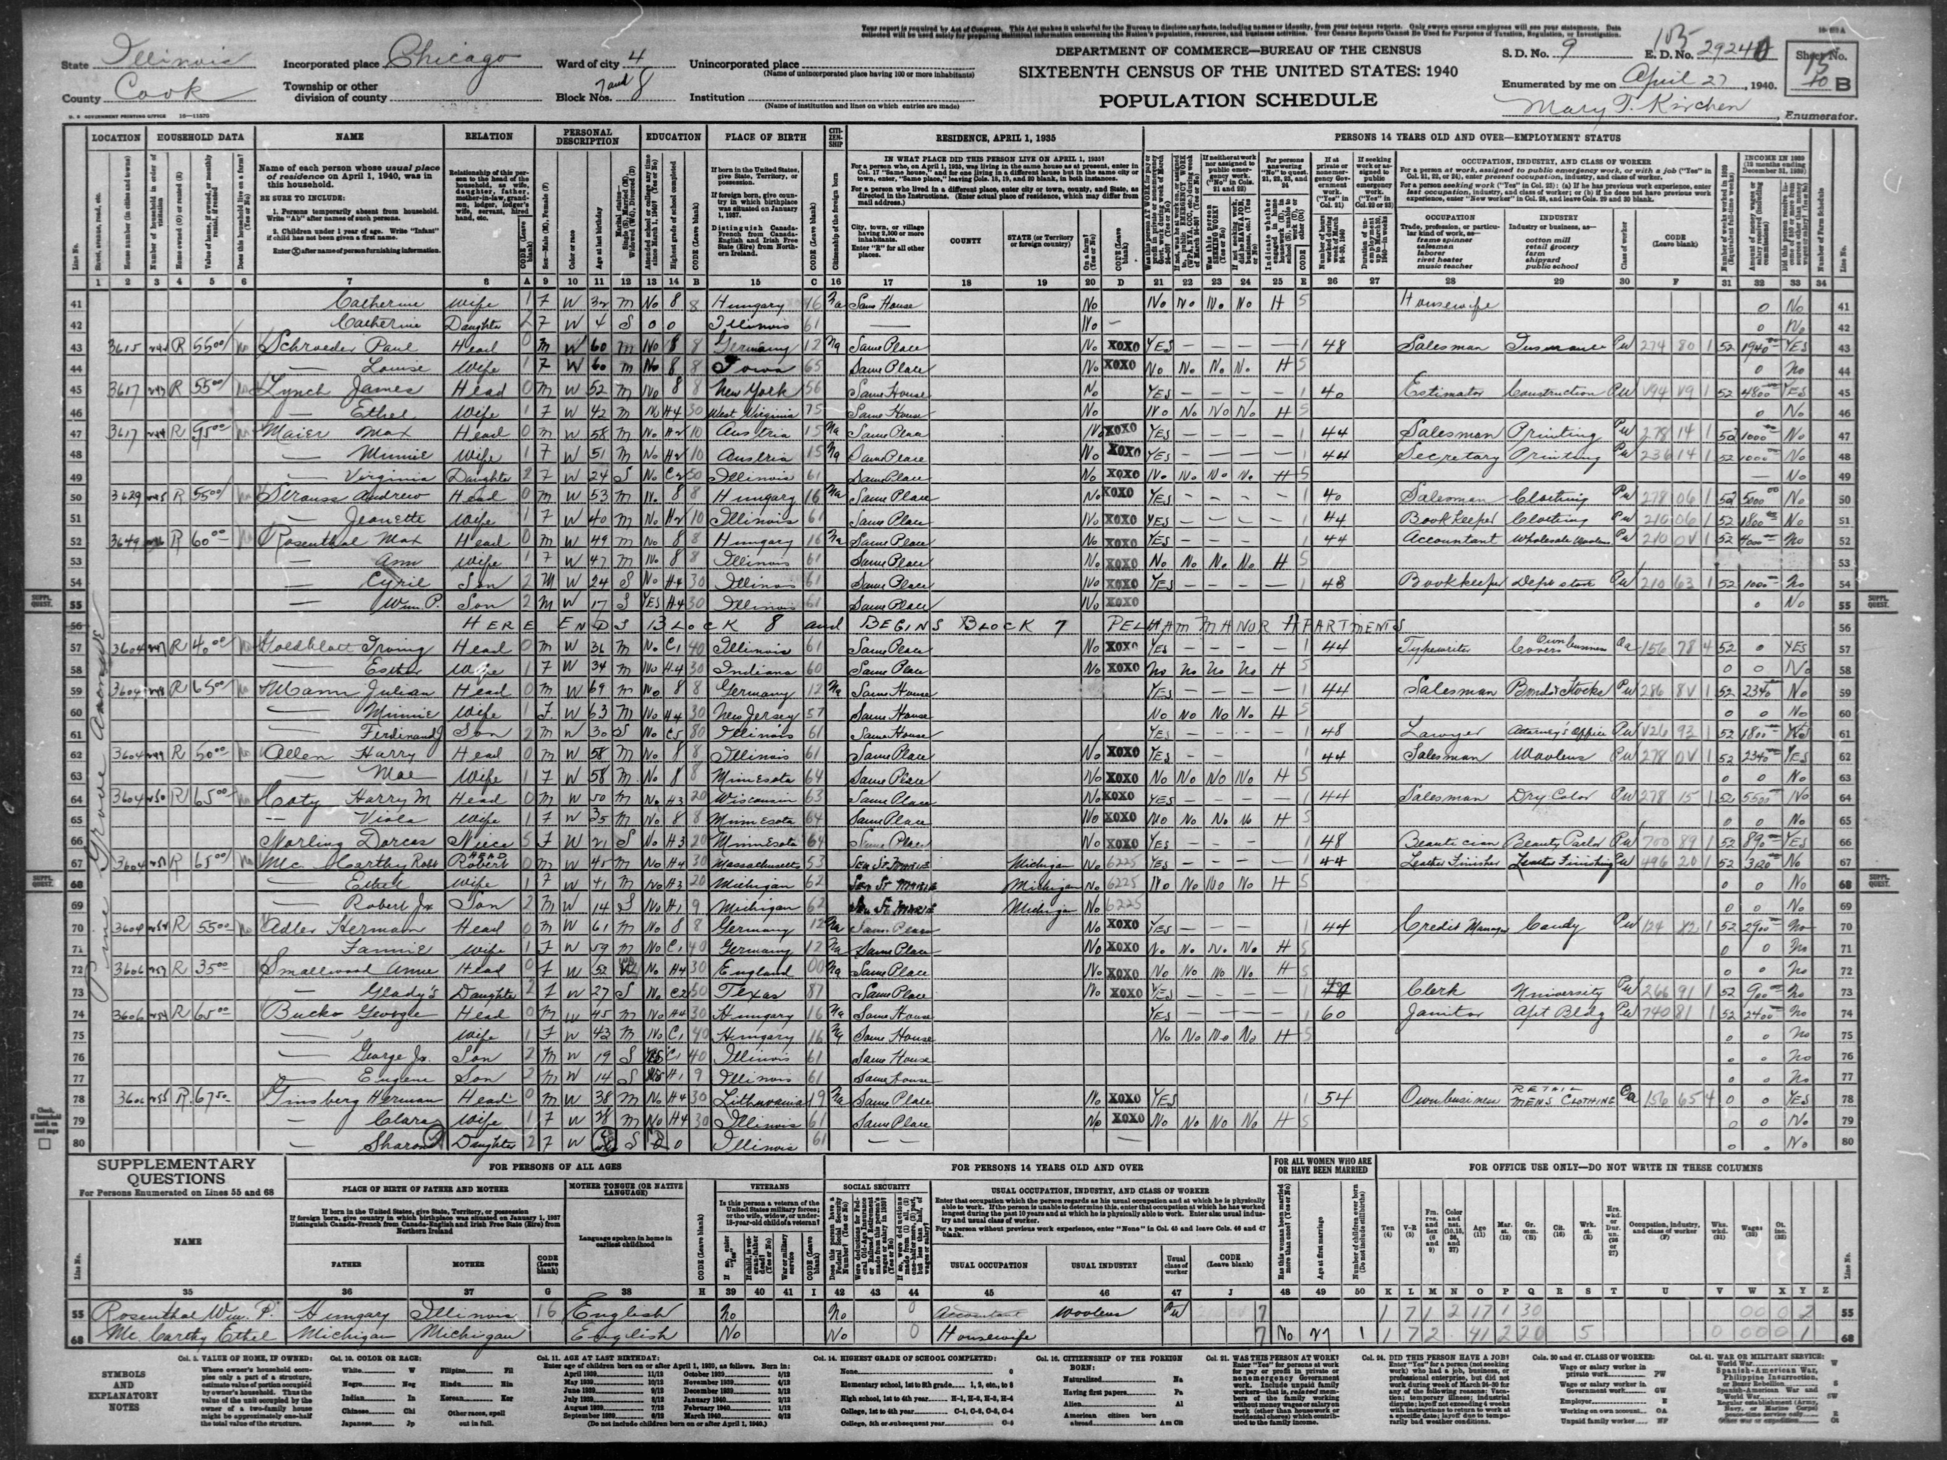
Paul & Louise Schroeder 1940 Census

Slide 14
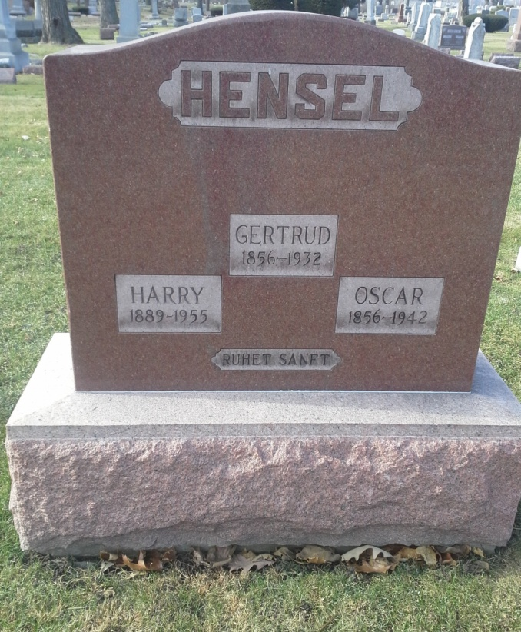
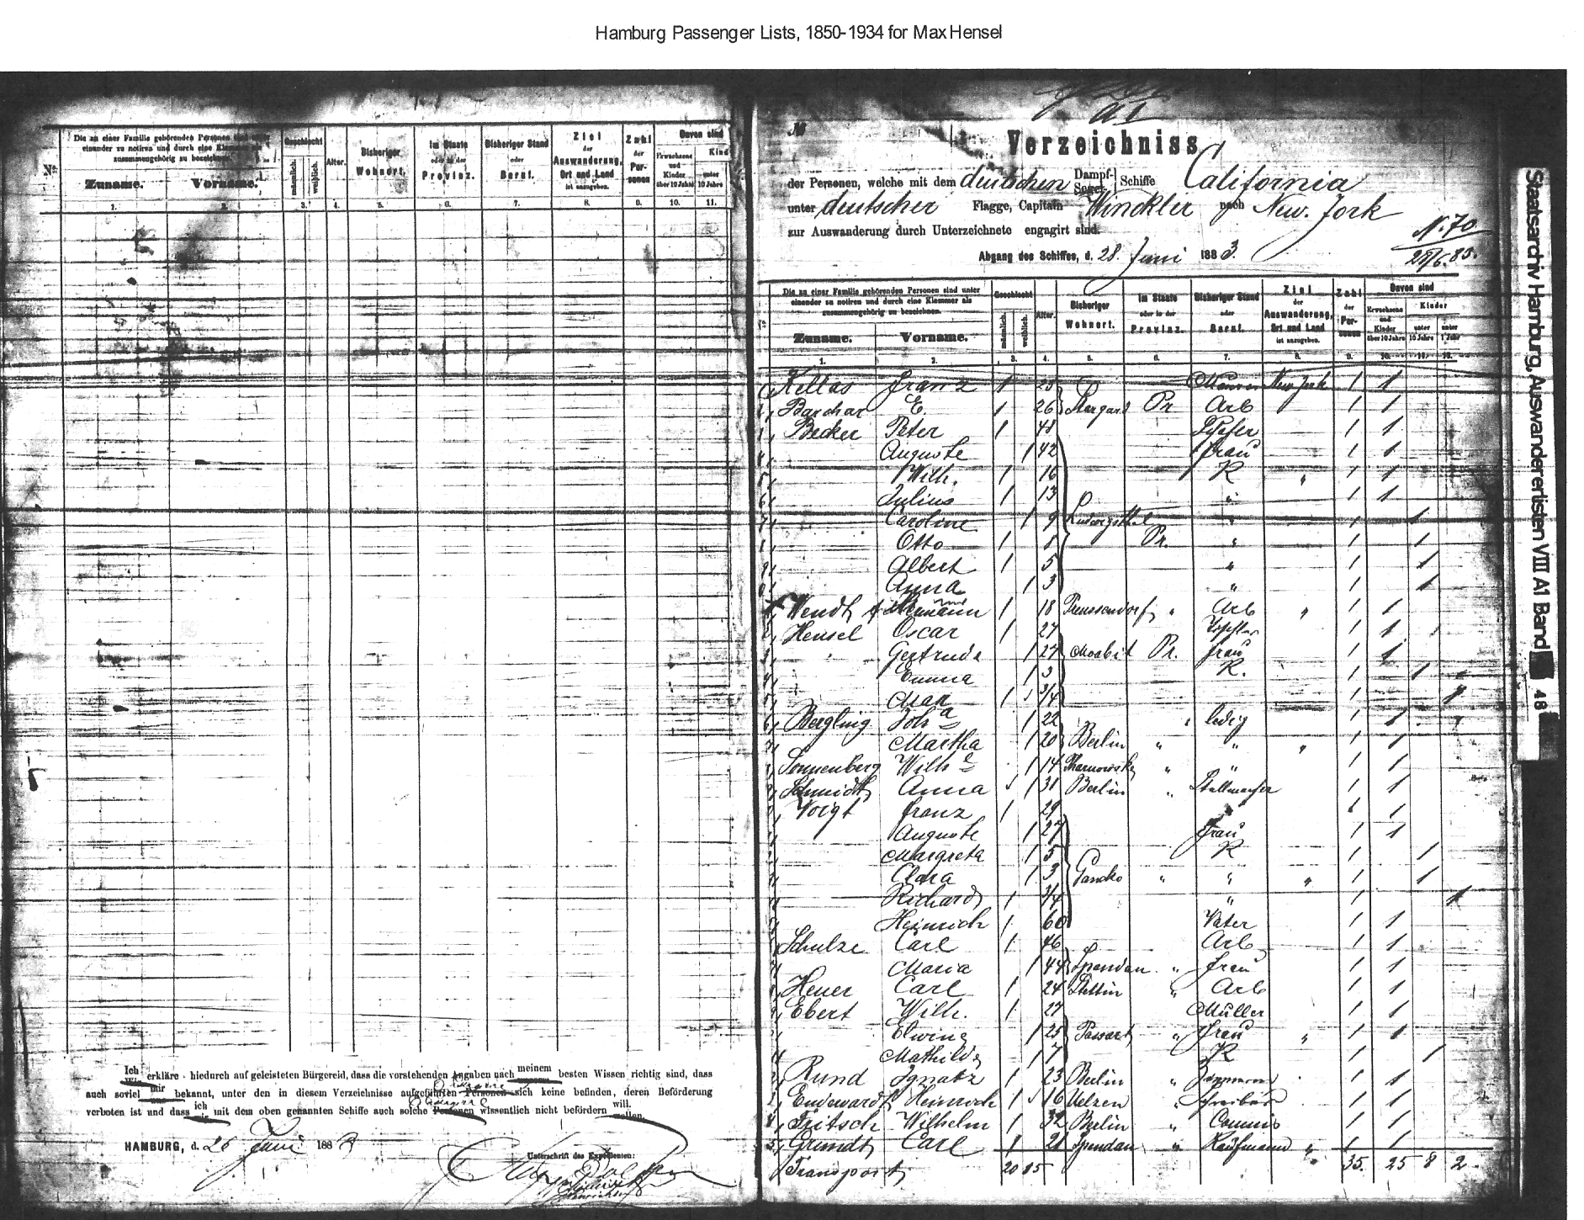
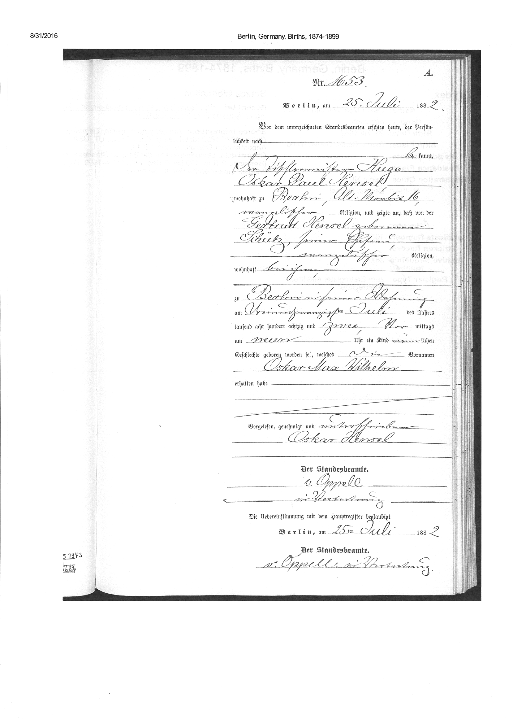
Oscar, Gertrud, Emma & Max Hensel from Moabit, Berlin, Germany,
Jun 28, 1883

Slide 15
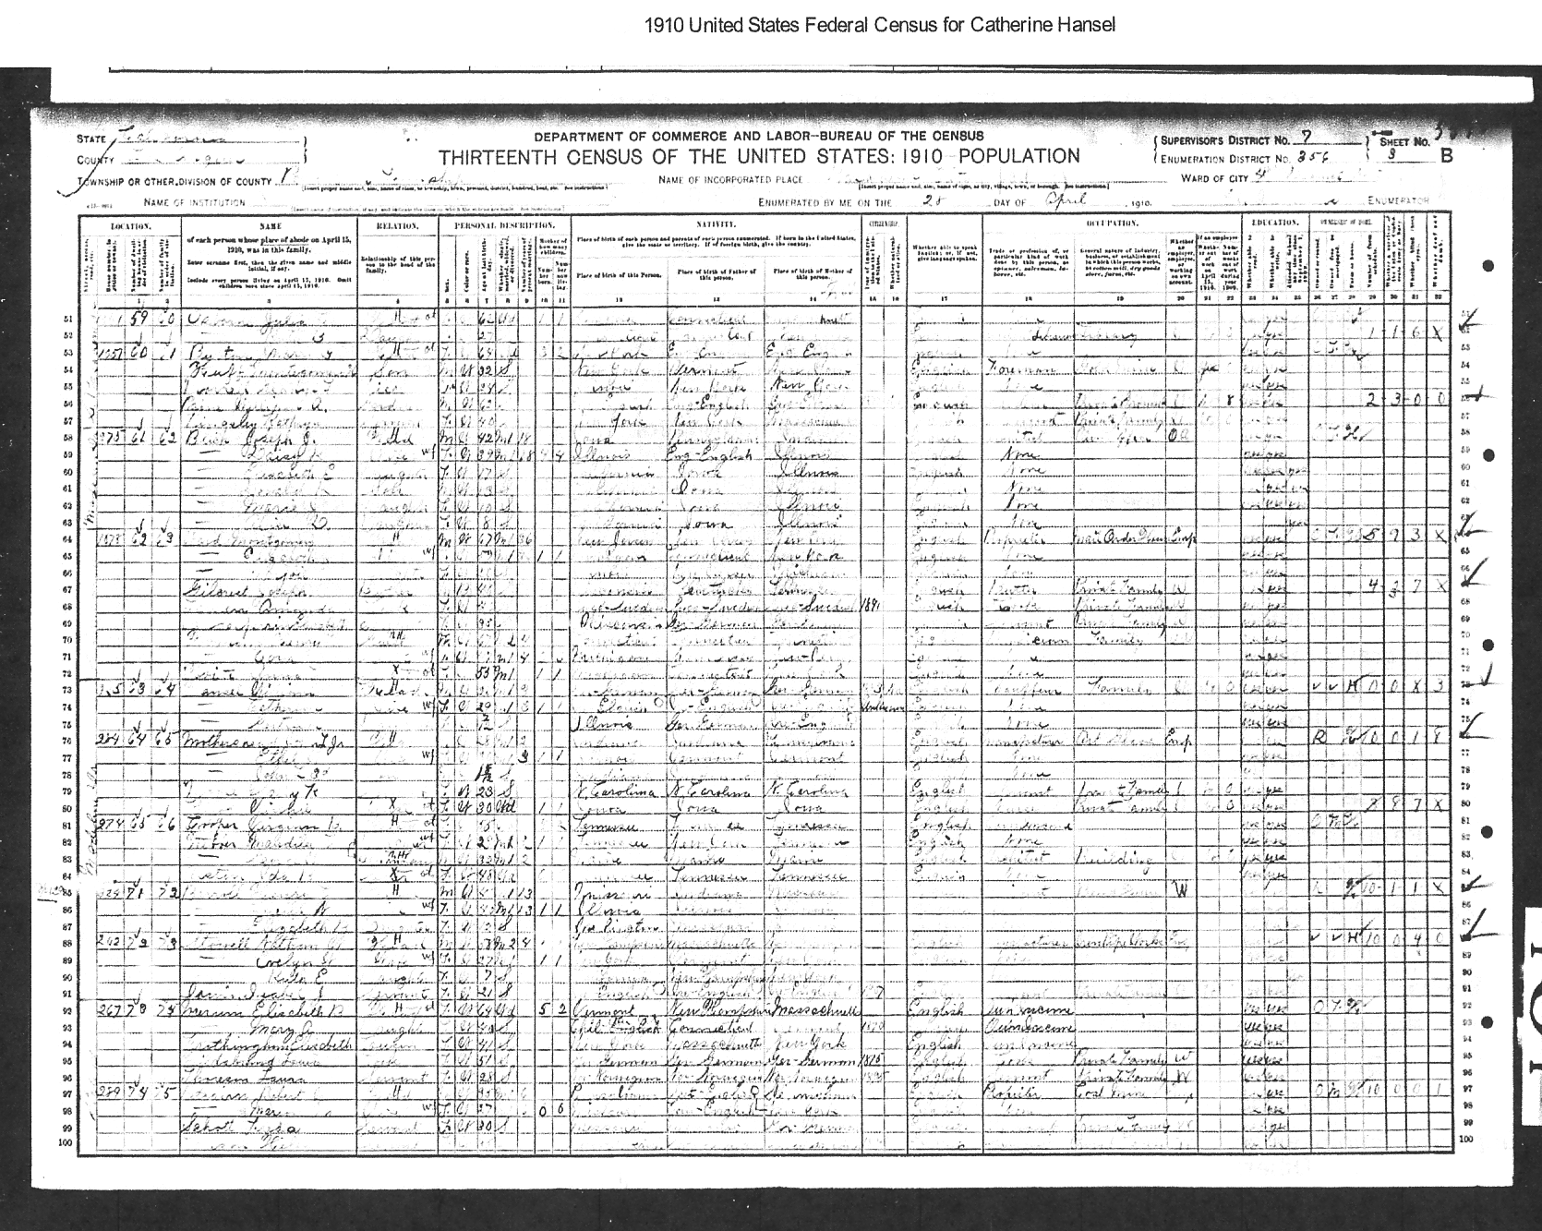
1910 US Census
Gertrude Hensel
Pasadena, CA

Slide 16
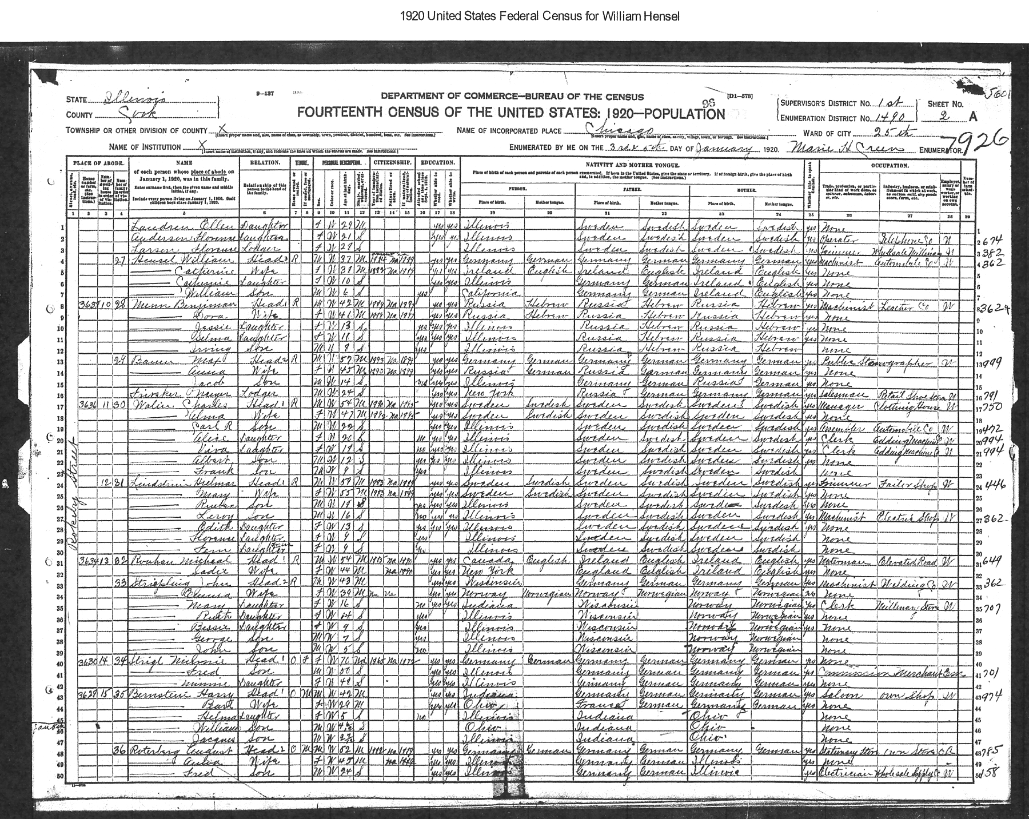
1920 US Census
Wm M Hensel

Slide 17
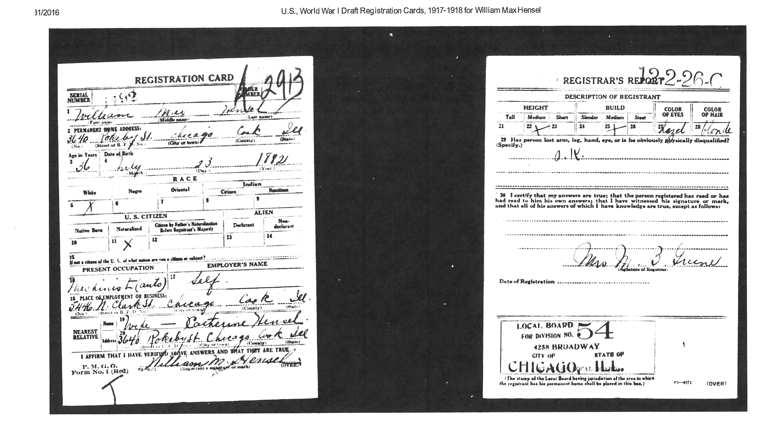
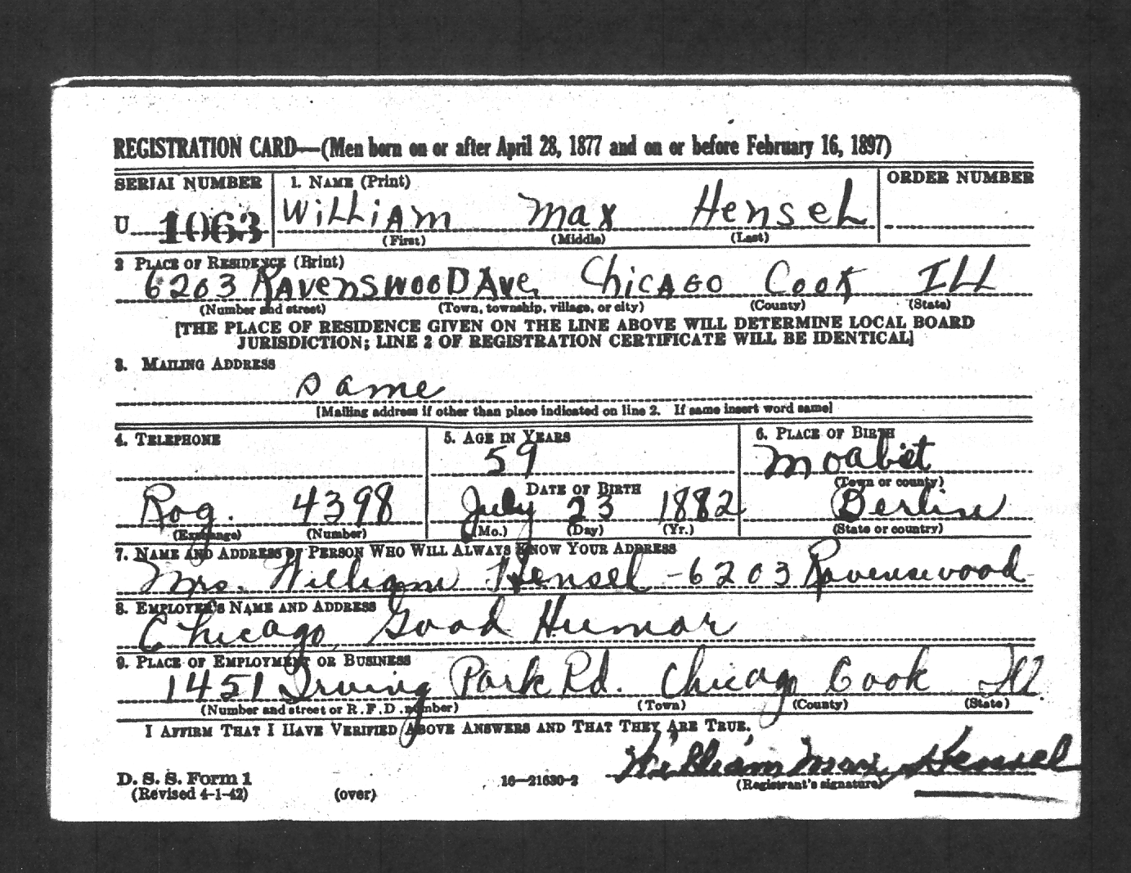
William Max Hensel

Slide 18
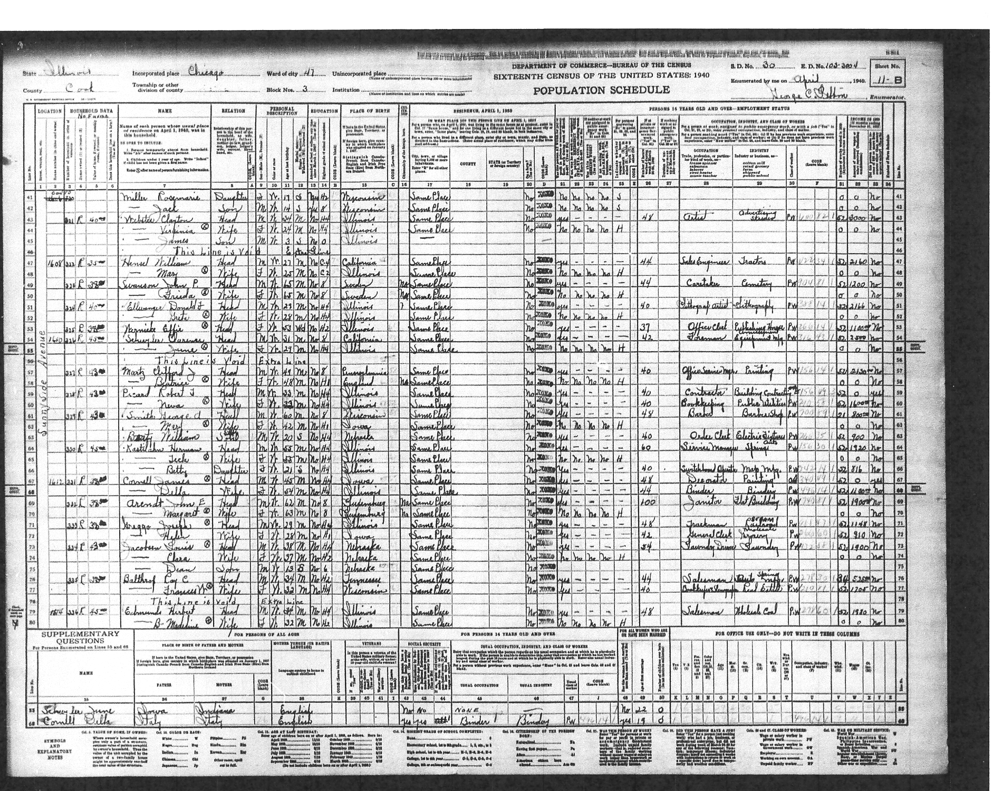
1940 US Census
William & Mary Hensel
Chicago

Slide 19
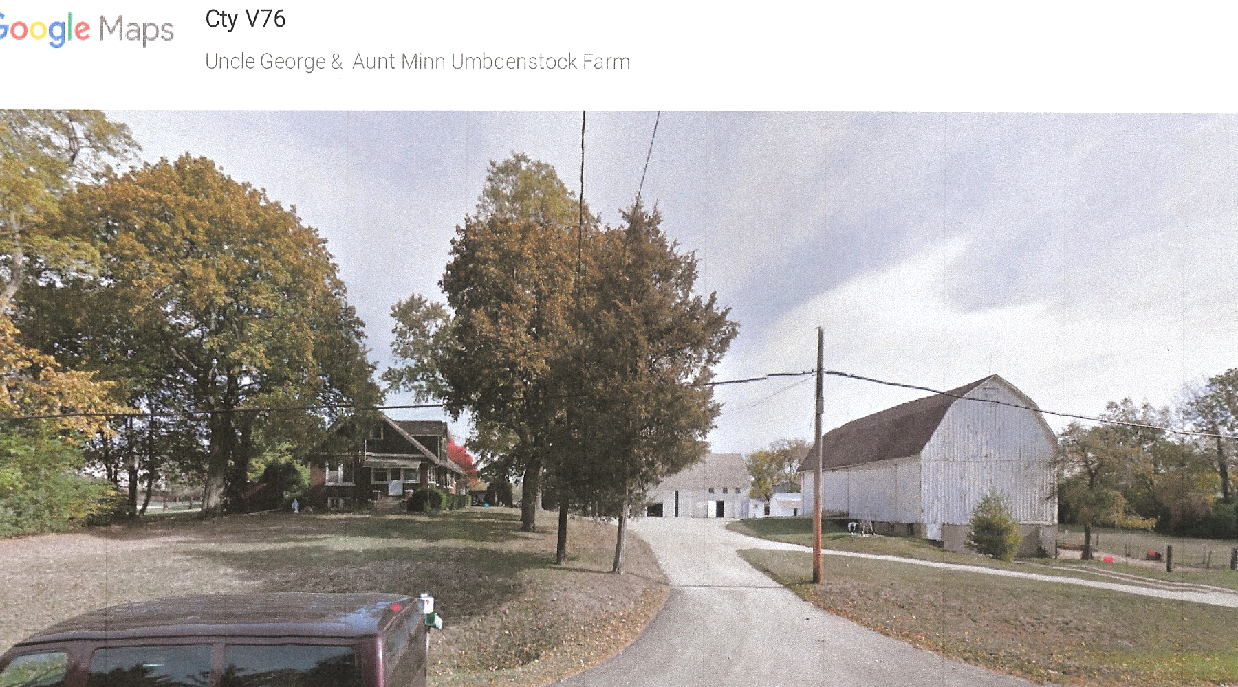
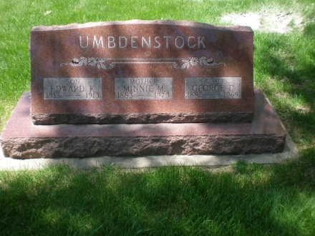
Just like 1957

Slide 20
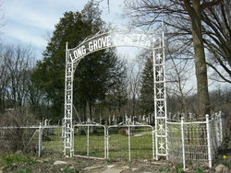
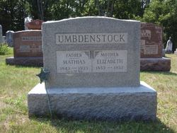
Mathias Umbdenstock (Jr.) & Elizabeth Ann Schroeder b. 1843-d.1933 b.1853-d.1912
Notes:
Resting place for Great Grandmother and Grandfather.
Elizabeth Schroeder was orphaned in Germany and arrived in US ca. 1890

Slide 21
Umbdenstock Tree
Ostheim, Haut-Rhin, Alsace France
1. Mathias Umbdenstock b. 1816 – d. 1851 b. Ostheim, Haut-Rhin, Alsace France d. Long Grove, IL
+ Salome Hinderman b. 1817- d. 1899 b. Haut-Rhin, Alsace, George Hershberger 1st marriage
2. Mathias b. 1843- d. 1933 b. Ostheim, Haut-Rhin, Alsace France , d Park Ridge, IL
+Catharine Sturm b. 1843- d. 1896 b. Ostheim, Haut-Rhin, Alsace France
3. Caroline Vehe b. 1866 – d. 1951
3. Emeline Lempker b. 1868 – d. 1948 m. Fred Lempker
3. John b. 1869 – d. 1953 m. Hattie Babcock
3. William b. 1874 – d. 1962 m. Caroline Vollmer
3. Catharine Biere b. 1876 – d. 1944
3. Edward J. b. 1879 – d. 1971 m. Mae Small
3. George b. 1882 – d. 1969 m. Minnie Kuhlman
3. Unknown Child
++ Anna Elizabeth Schuetz b. 1853 – d. 1932 b. Hessen Kassel, m. Schroeder, F. William Schuetz 3. Erna b. 1898 – d. 1986
+ Herman Brandt b.
4. Herman b. 1923 – d. 2015
4. Elaine b. 1924- d.
3. Elsa Elizabeth b. 1899 - d. 1997 b. Long Grove, IL, d. Park Ridge, IL
+ Louis Julius Ahrens b. 1899 - d. 1950 b. Fairmont, MN, d. Park Ridge, IL
4. Lorraine b. 1923 – d.
+ Norman Parfitt b.
5. Dewayne b. 1948
5. Daryl b.
5. Glenn b.
4. Jean Ahrens b. 1925-d. 2003
+ Robert Powers b. 1925 – d.
5. James b. 1948
5. Linda b. 1950
5. Judith b. 1954
5. Laurie b. 1957
5. Jennie b. 1960

Slide 22
Melchior Umbdenstock Tree
Ostheim, Haut-Rhin, Alsace France
Melchior Umbdenstock ?
+ ?
2. Mathias Umbdenstock b. – d. b. Ostheim, Haut-Rhin, Alsace France
+ Elisabeth Vogel b. -d.
3. Mathias b. 1738- d. b. Ostheim, Haut-Rhin, Alsace France ,
+Maria Magdelena Vogel b. - d.
4. Johann Michael b. 1750 – d. 1814
+ Maria Magdalena Umbdenst.* b. 1756 – d. 1808 See Separate Page
5. Maria Magdalena b. 1779 – d.
5. Michael b. 1780 - d. 1815
5. Nicolas le jeune b. 1782 – d. 1835
+ Maria-Salome Hintermann b. 1780 – d. 1822
6. Salome b. 1820 – d. 1822
6. Madelaine Helena b. 1813 – d. 1853 Buried in Ostheim
+ Andreas Sturm b. 1799 – d. 1874 d. Newawka, Cass, NE
7. Mary Magdelene b. 1832 – d. 1869
+ Frederic Kiechel b. 1826 – d. 1858
6. Mathias b. 1817 – d. 1851
+Salome Hintermann b. 1818 – d. 1899 b. Hunawihr
7. Mathias b. 1843 – d. 1933
7. Marie Salome b. 1850 – d. 1920
Notes:
Maria Magdalena Umbdenstock can be traced to Ullrich
Johann Nicolaus 1731-1801 + Maria Magdalena Umbdenstock
Mathias umbdenstock 1710-1791 + Margaretha Vogel
Daniel Umbdenstock b. ?–d 1735 + Anna Barbara Kessel
Mathias b. 1630 – d. 1698 +Madeleine Bohm b. 1630
Melchior b. 1575 – d. 1612 + Appolonia Vogel b.1589-d. 1672
Melchior b. 1533 –d. 1605 +Cecile Meyer b.1555-d. 1619
Ullrich b.?-d. 1553
Melchior b. 1514- d.1540
Ullrich b.?-d. 1490

Slide 23
Maria Magdalena Umbdenstock Tree
Ostheim, Haut-Rhin, Alsace France
1. Ullrich Umbdenstock b. ? – d. 1490
2. Melchior b. 1514 – d. 1540 b. Ostheim, Haut-Rhin, Alsace France
3. Ullrich b. ?- d. 1553
4. Melchior b. 1533 – d. 1605
+ Cecile Meyer b. 1555- d. 1619
5. Melchior b. 1575-d. 1612
+ Appolonia Vogel b. 1589-d. 1619
6. Mathias b. 1630 – d. 1698
+ Madeleine Bohm b. 1630 – d. ?
7. Daniel b. ? – d. 1735
+ Anna Barbara Kessel
8. Mathias b. 1710 – d. 1791
+ Margaretha Vogel
9. Maria Magdalena Umbdenstock* b. 1756 – d. 1808 See Separate Page
+ Johann Nicolaus b. 1731-1801
Notes:
Maria Magdalena Umbdenstock can be traced to Ullrich
Johann Nicolaus 1731-1801 + Maria Magdalena Umbdenstock
Mathias umbdenstock 1710-1791 + Margaretha Vogel
Daniel Umbdenstock b. ?–d 1735 + Anna Barbara Kessel
Mathias b. 1630 – d. 1698 +Madeleine Bohm b. 1630
Melchior b. 1575 – d. 1612 + Appolonia Vogel b.1589-d. 1672
Melchior b. 1533 –d. 1605 +Cecile Meyer b.1555-d. 1619
Ullrich b.?-d. 1553
Melchior b. 1514- d.1540
Ullrich b.?-d. 1490

Slide 24
Salome Hintermann Tree
Hunawihr, Haut-Rhin, Alsace France
1. Andreas Hintermann b. – d.
+ Maria Salome Winter. b. 1721 – d. b. Hunawihr ; Jacob Winter & Barbara Heimel
2. Georg Hintermann b. 1755 – d. 1827 b. Hunawihr
+ Maria Salome Vogel b. 1753– d. 1823 b. Hunawihr; f. Johannes Vogel?
3. Andreas Hintermann b. 1784- d. 1842 b. Hunawihr
+ Maria Ursula Munsch b. 1786 – d. 1844
4. Salome Hintermann b. 1818– d. 1899 b. Horbourg-wihr
+ Mathias Umbdenstock Sr. b. 1817 – d. 1851 5. Mathias Jr. b. 1843 – d. 1933
5. Marie Salome b. 1850 – d. 1920
Notes:
http://emig.free.fr/

Slide 25
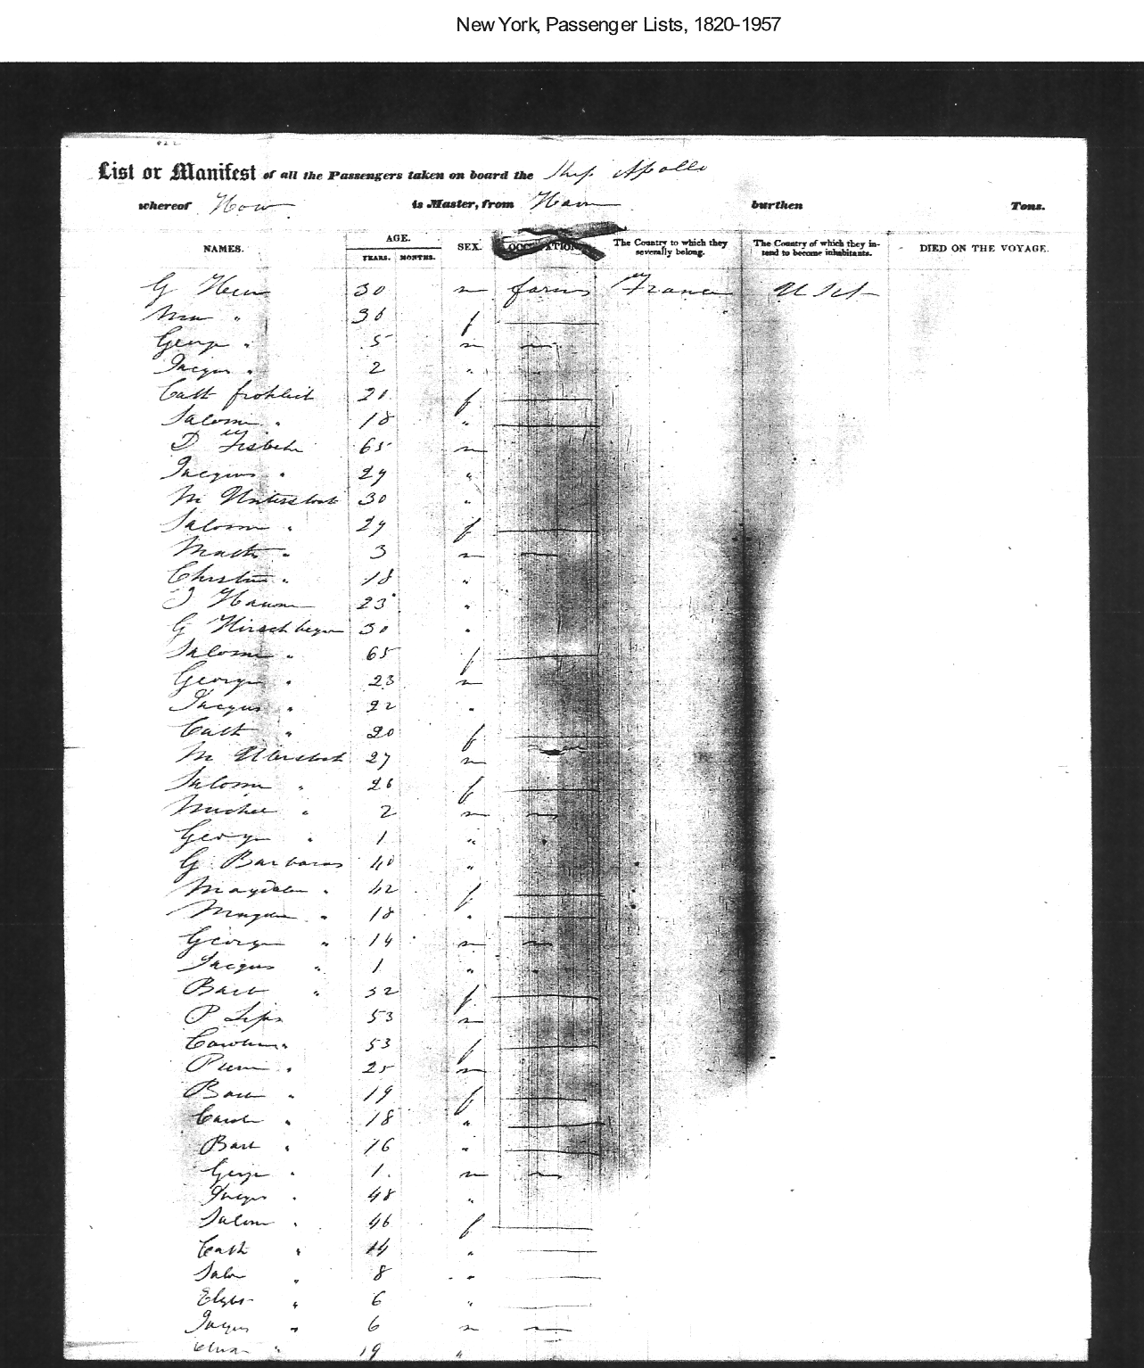
Ship Apollo Manifest
19 July 1847
Le Havre – New York
Mathias Umbdenstock 30 yrs
& Salome 29 yrs
Mathias Jr. 3 yrs
George Herschberger
Michael Umbdenstock
Many of these passengers are from Alsace & settle in Lake County, Ill

Slide 26
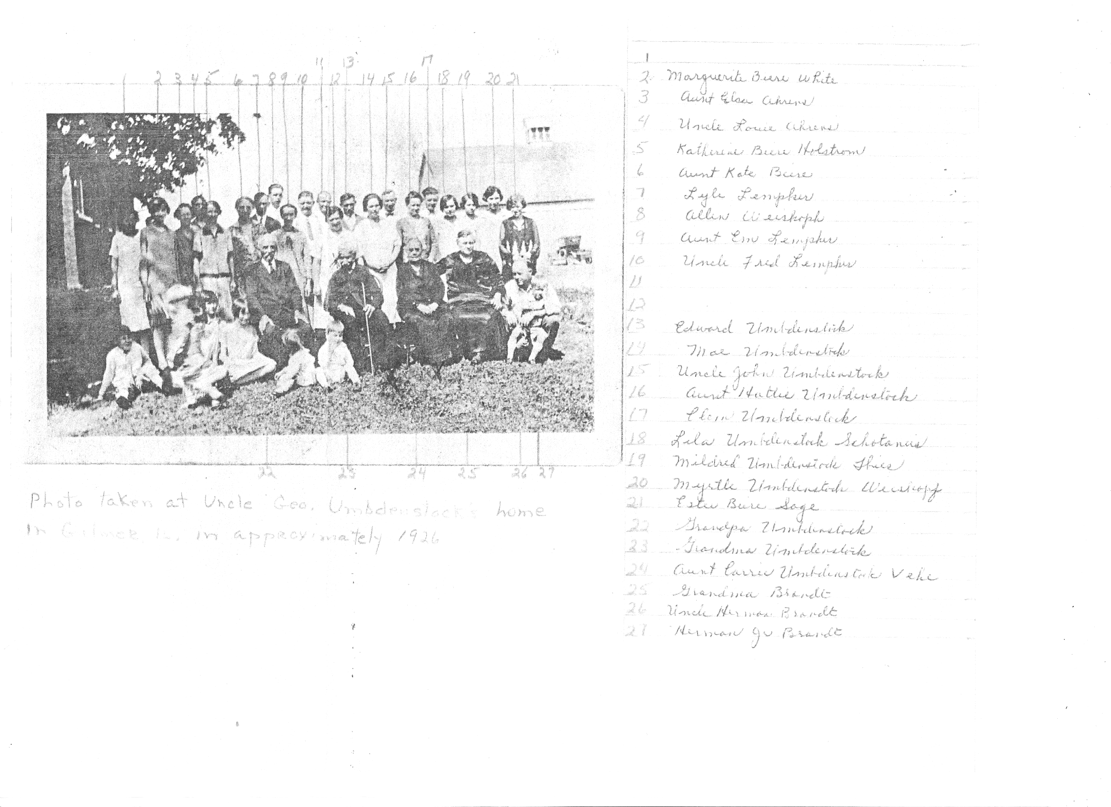
Umbdenstock ca. 1926

Slide 27
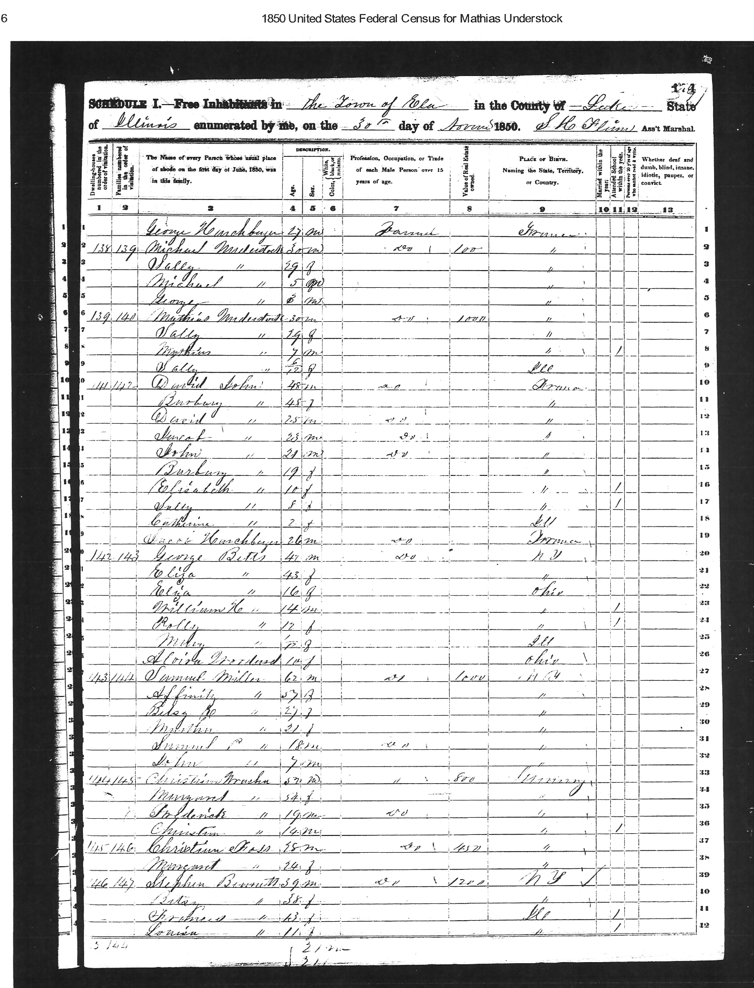
1850 US Census
Ela, Lake County Ill
Michael Umbdenstock age 30 yrs
Mathias Umbdenstock Sr.
age 30 yrs
Mathias jr. age 7 yrs

Slide 28
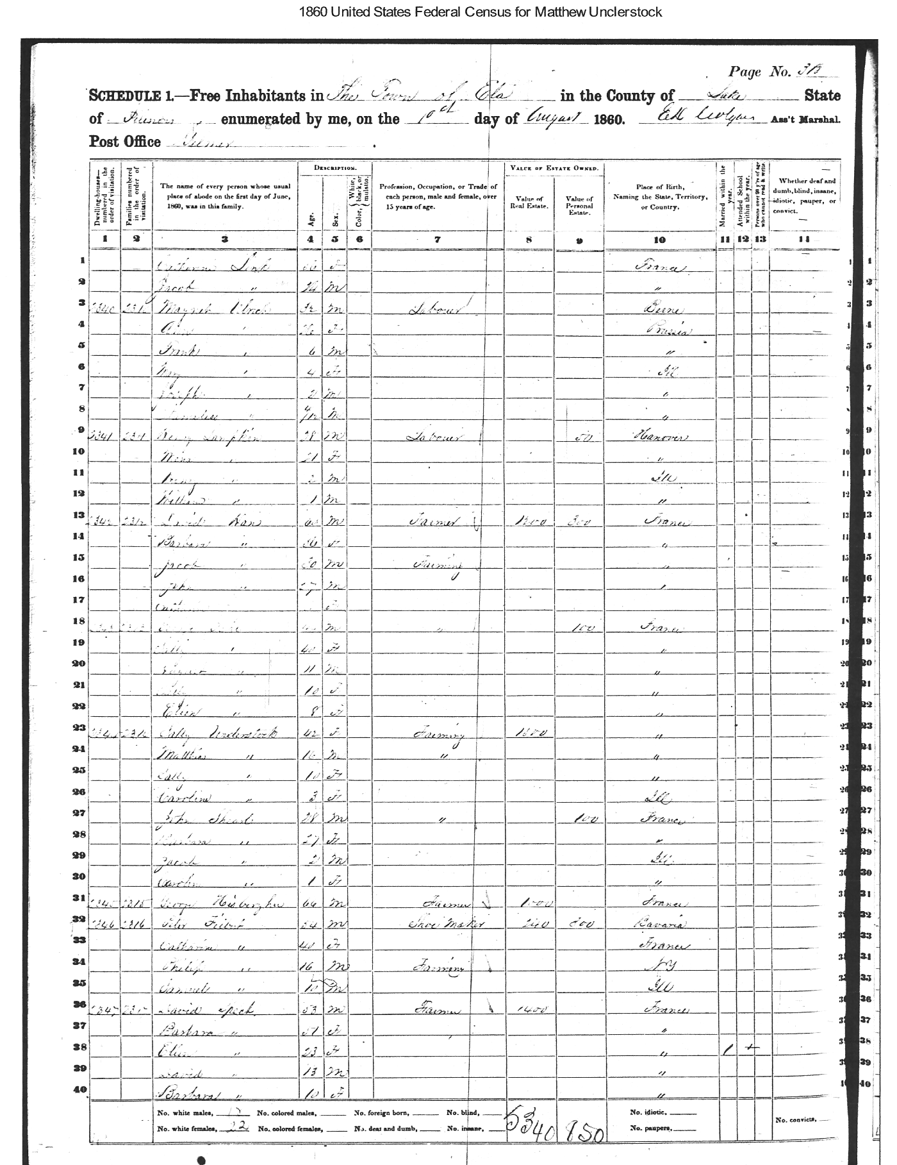
1860 US Census
Ela, Lake County Ill
Sallie Umbdenstock
age 42 yrs
Mathias Jr. age 16 yrs
Sally age 10 yrs
Caroline age 3 yrs

Slide 29
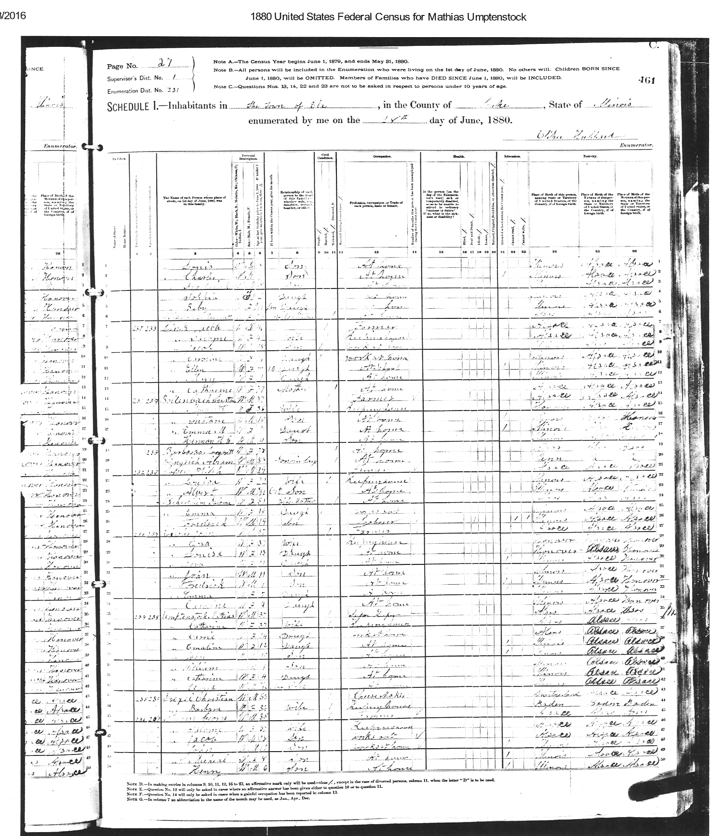
1880 US Census
Ela, Lake County Ill
Mathias Jr. age 37 yrs
Catherine (Sturm) 37 yrs
Carrie age 10 yrs
Emaline age 12 yrs
John age 10 yrs
William age 6 yrs
Edward age 4 yrs
George Sturm 35 yrs
Salome 37 yrs

Slide 30
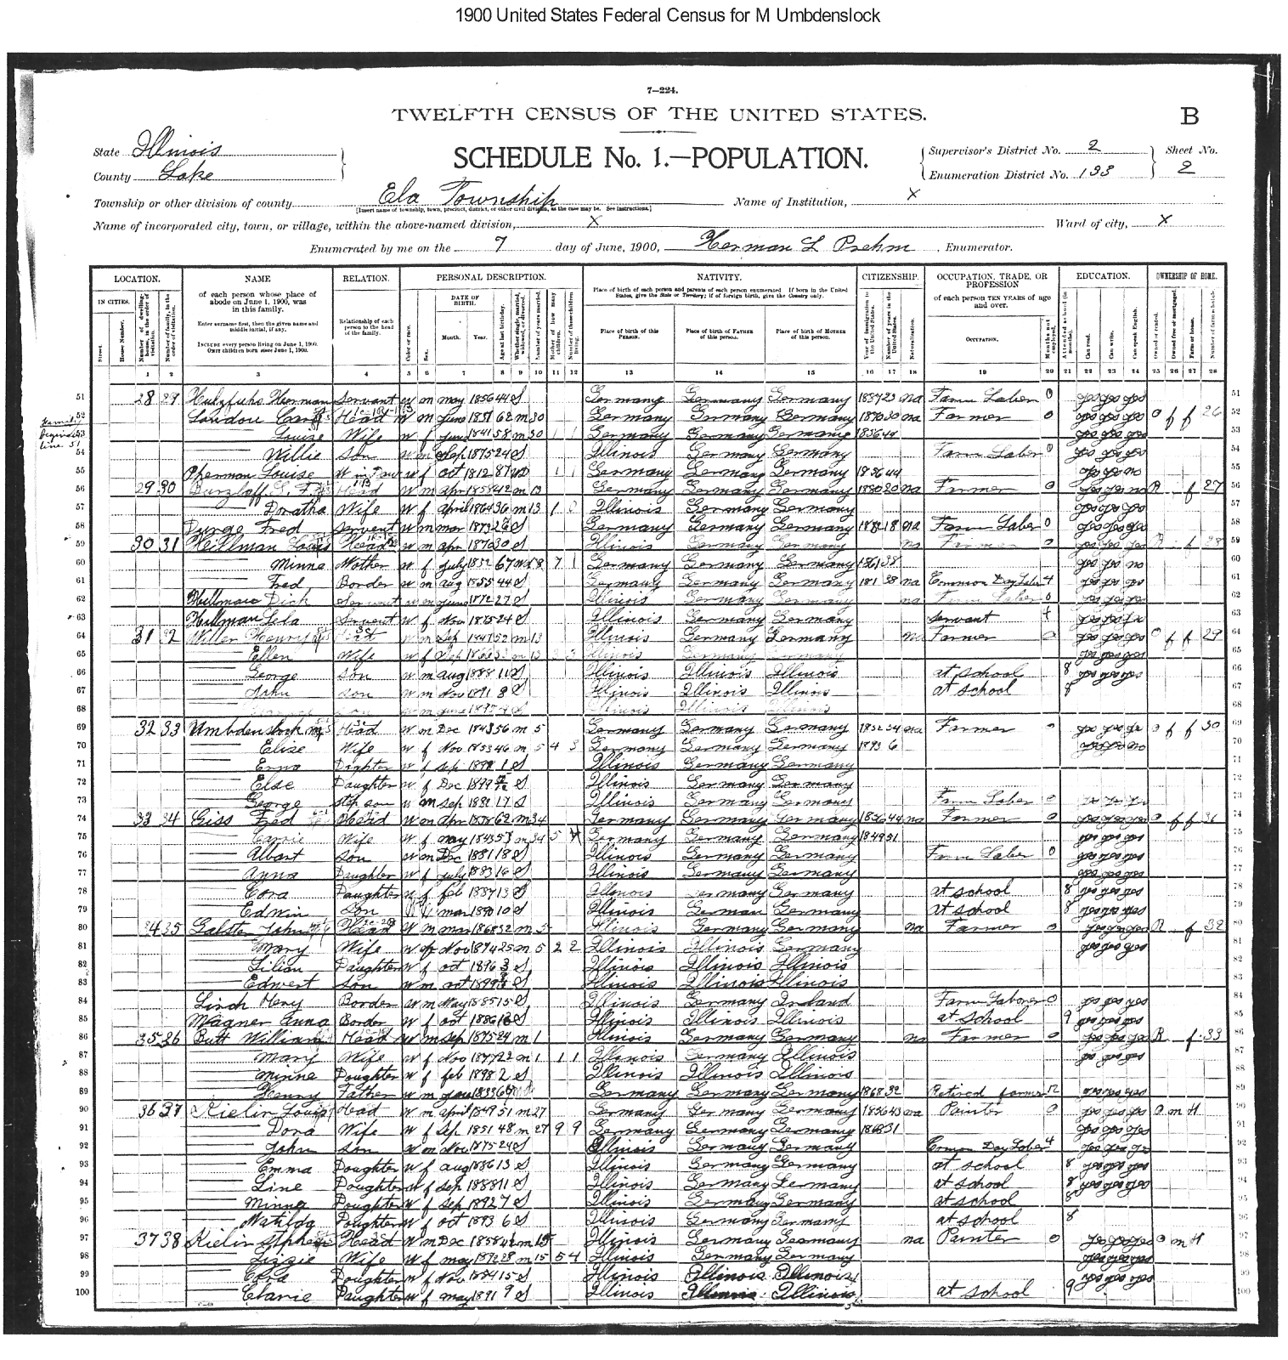
1900 US Census
Ela, Lake County Ill
Mathias Jr. age 56 yrs
Elise 46 yrs
Erna age 1 yrs
Elsa age <1 yrs
George age 17 yrs
George Sturm 35 yrs
Salome 37 yrs

Slide 31
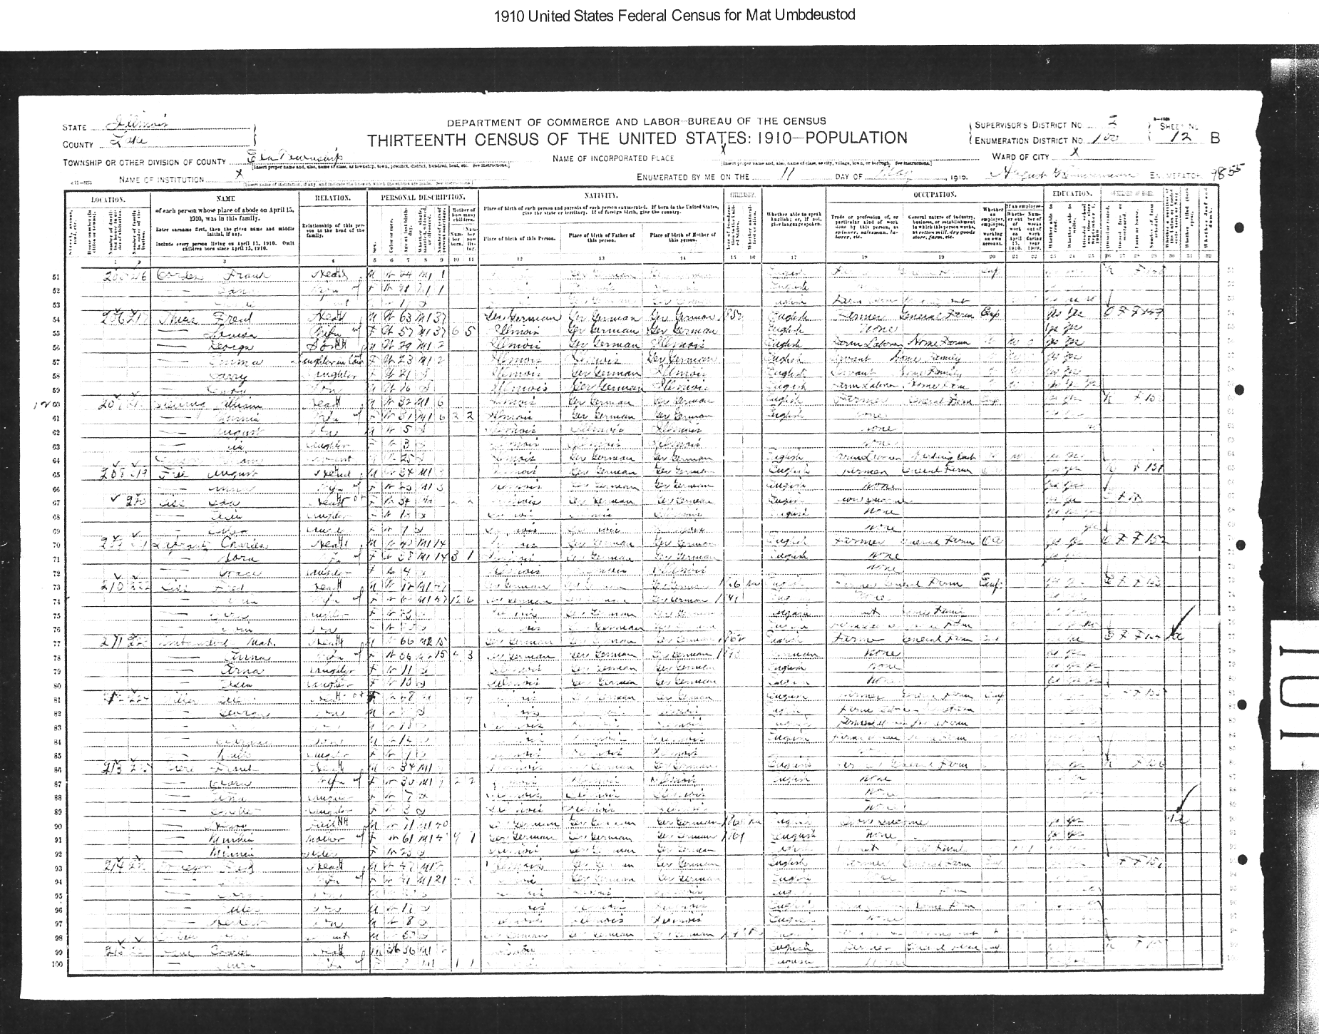
1910 US Census
Ela, Lake County Ill
Mathias Jr. age 66 yrs
Anna 56 yrs
Erna age 11 yrs
Elsa age 10yrs

Slide 32
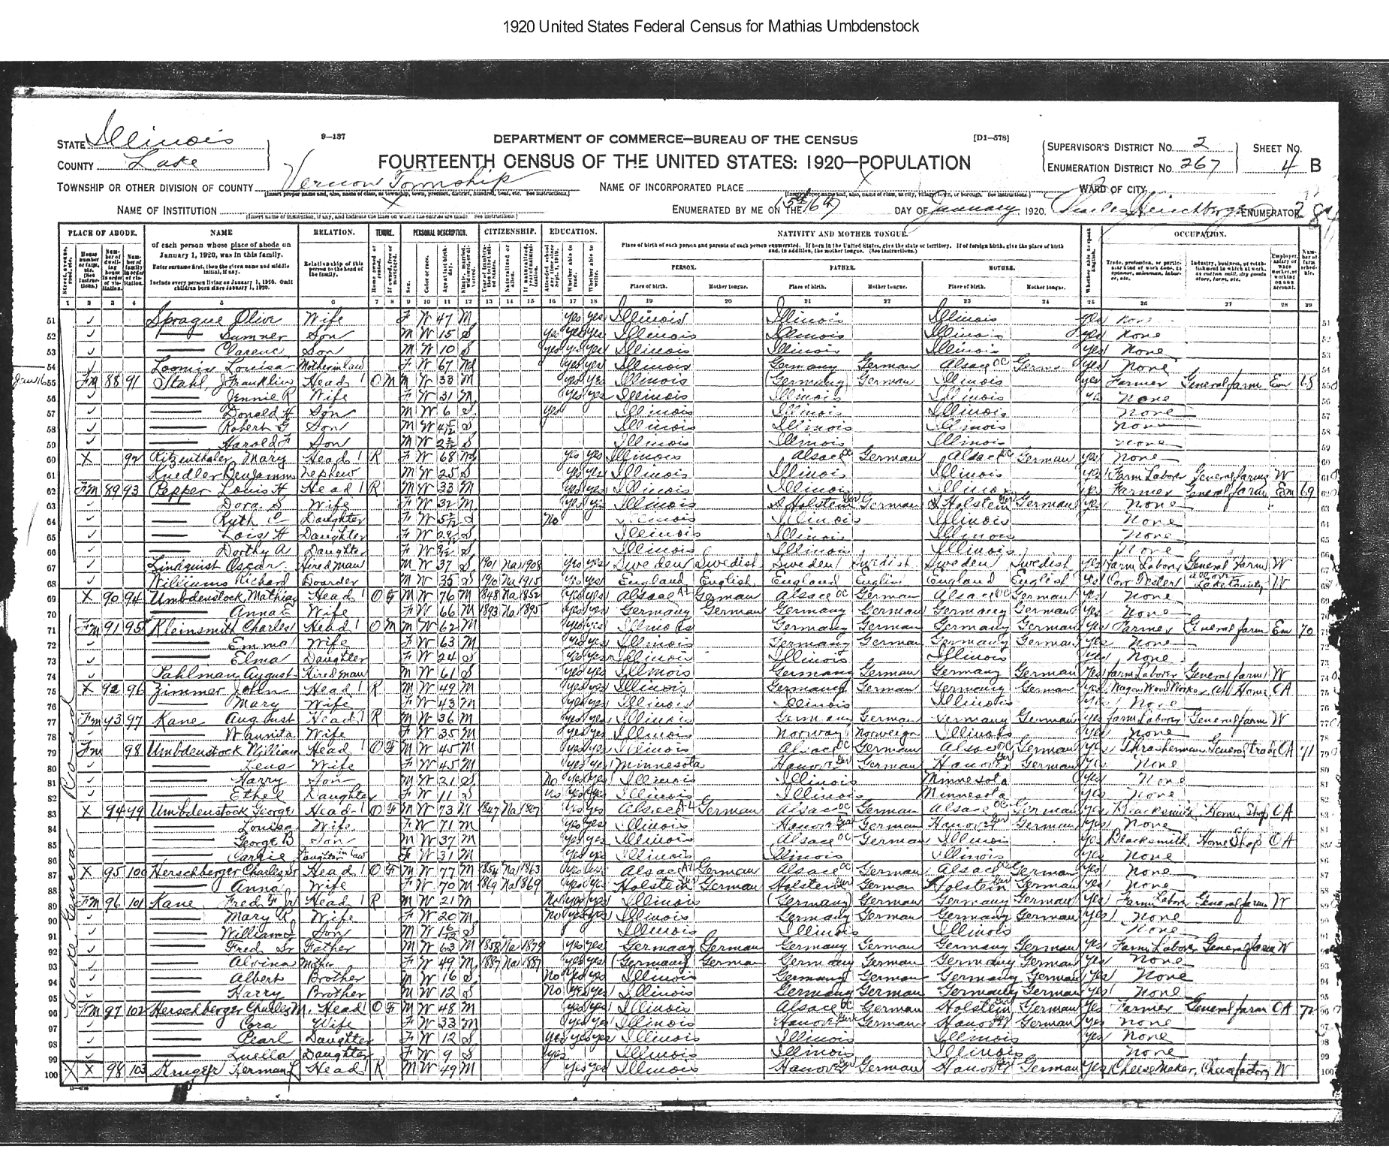
1920 US Census
Vernon Twp, Lake County Ill
Mathias Jr. age 76 yrs
Elise 66 yrs

Slide 33
Madelaine Umbdenstock Sturm
1813-1853 marries Andreas Sturm
Ostheim ,Alsace

Slide 34
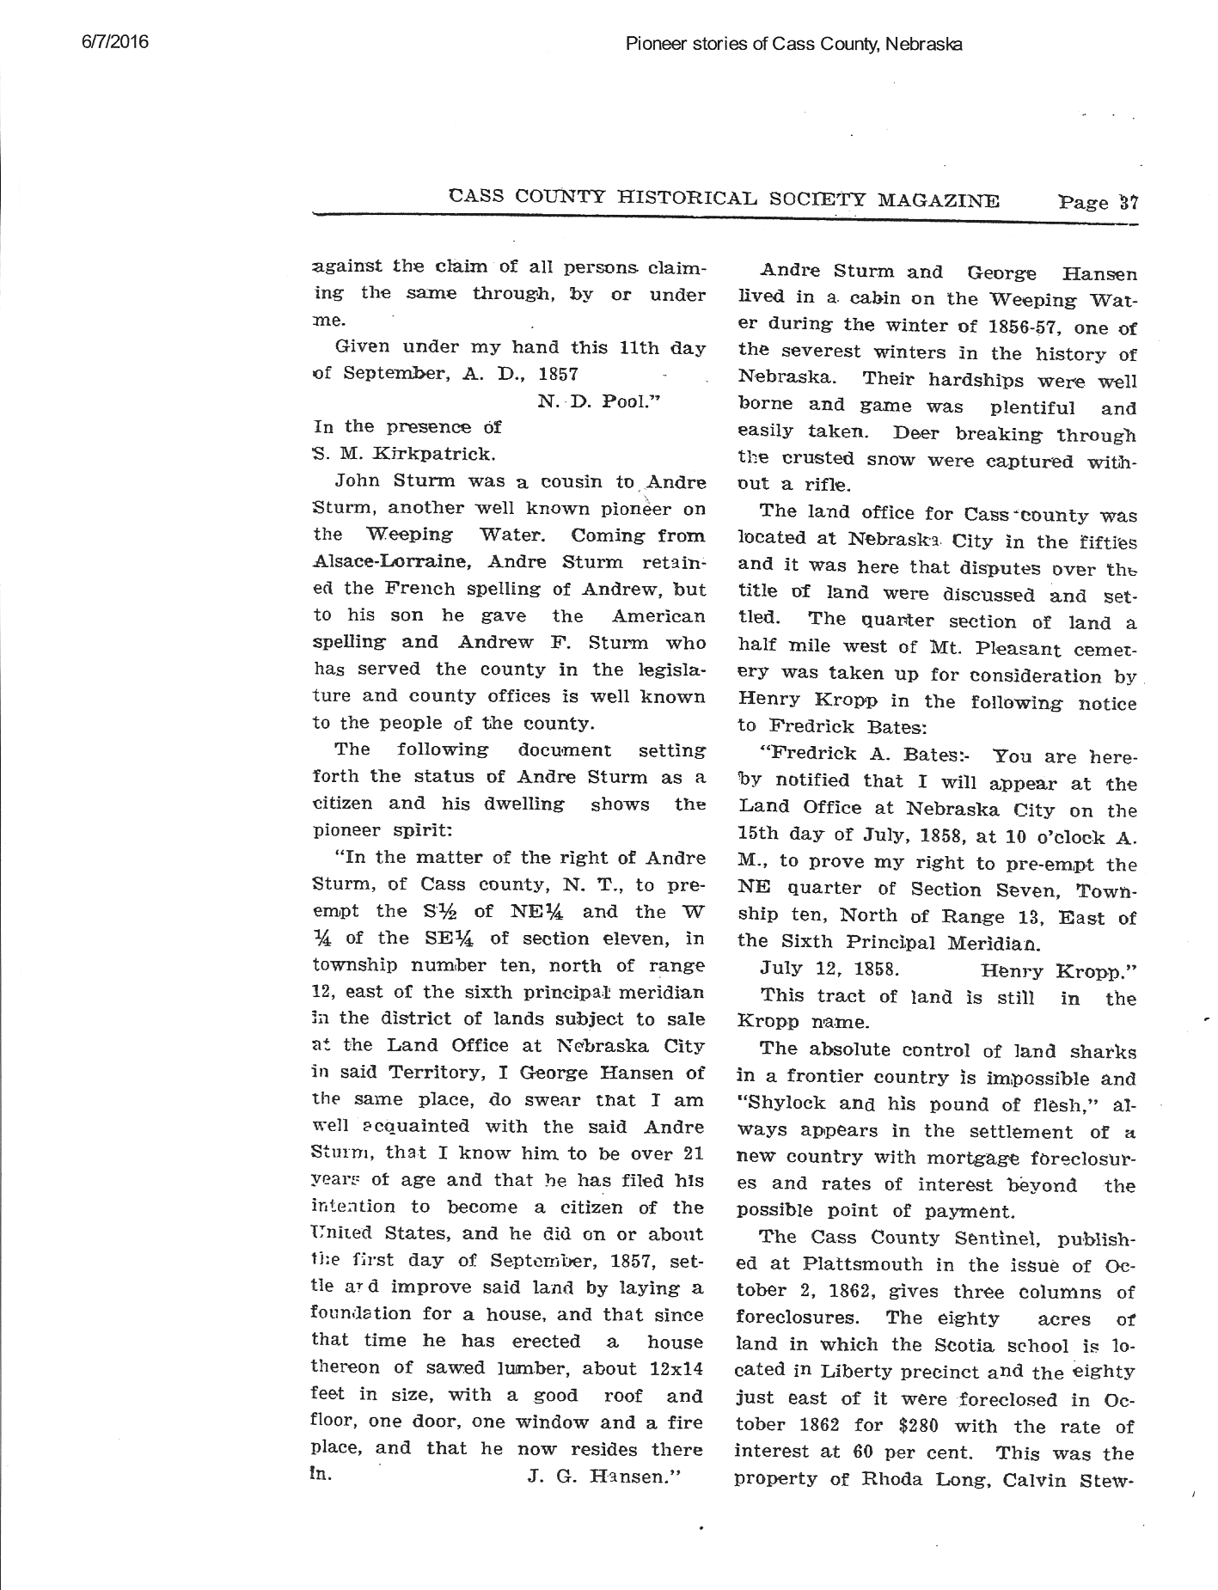
From: Pioneer stories of Cass County, Nebraska (dbase on-line) Ancestry Operations Provo, UT 2005
Who is John Sturm?
Andre Sturm
Copy taken from another Ancestry Tree

Slide 35
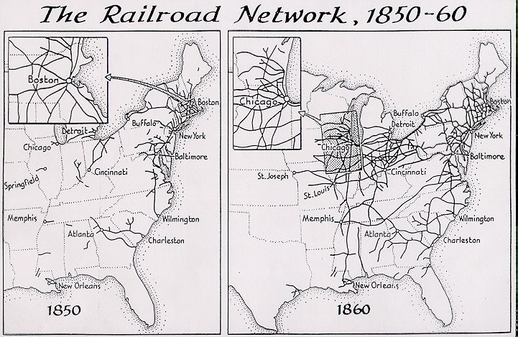

Slide 36
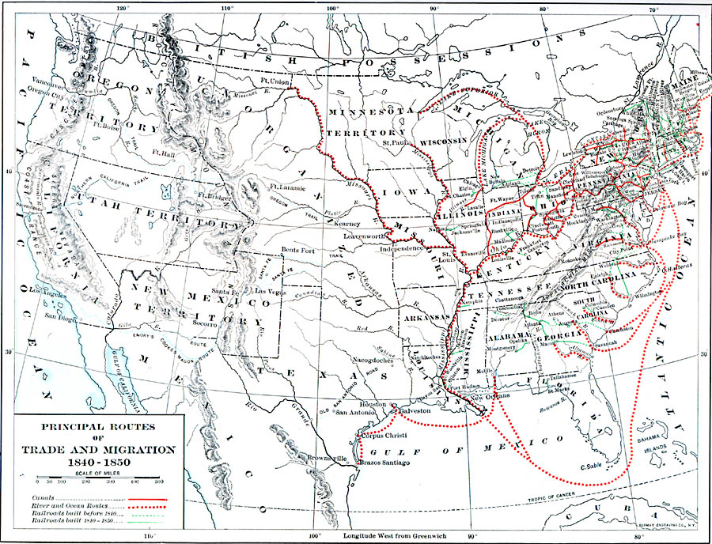

Slide 37
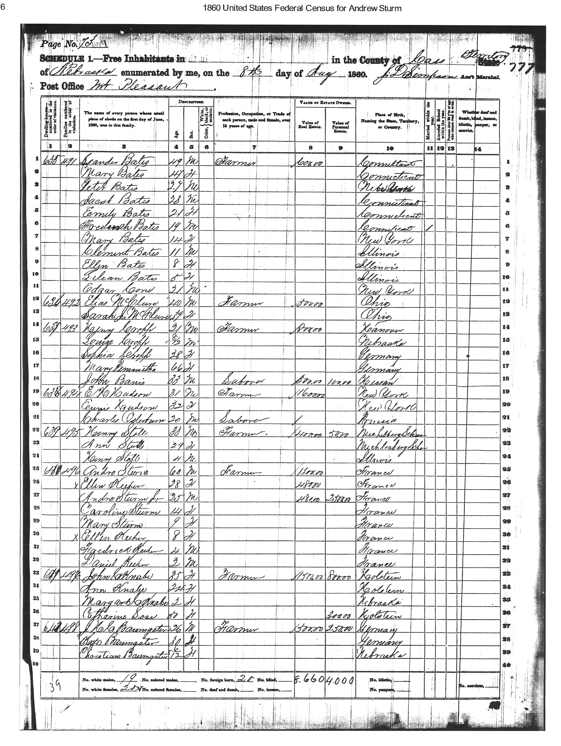
1860 US Census
Mt Pleasant Twp
Cass Co. NE
Andre Sturm, 60 yrs
Andrew, 25 yrs

Slide 38
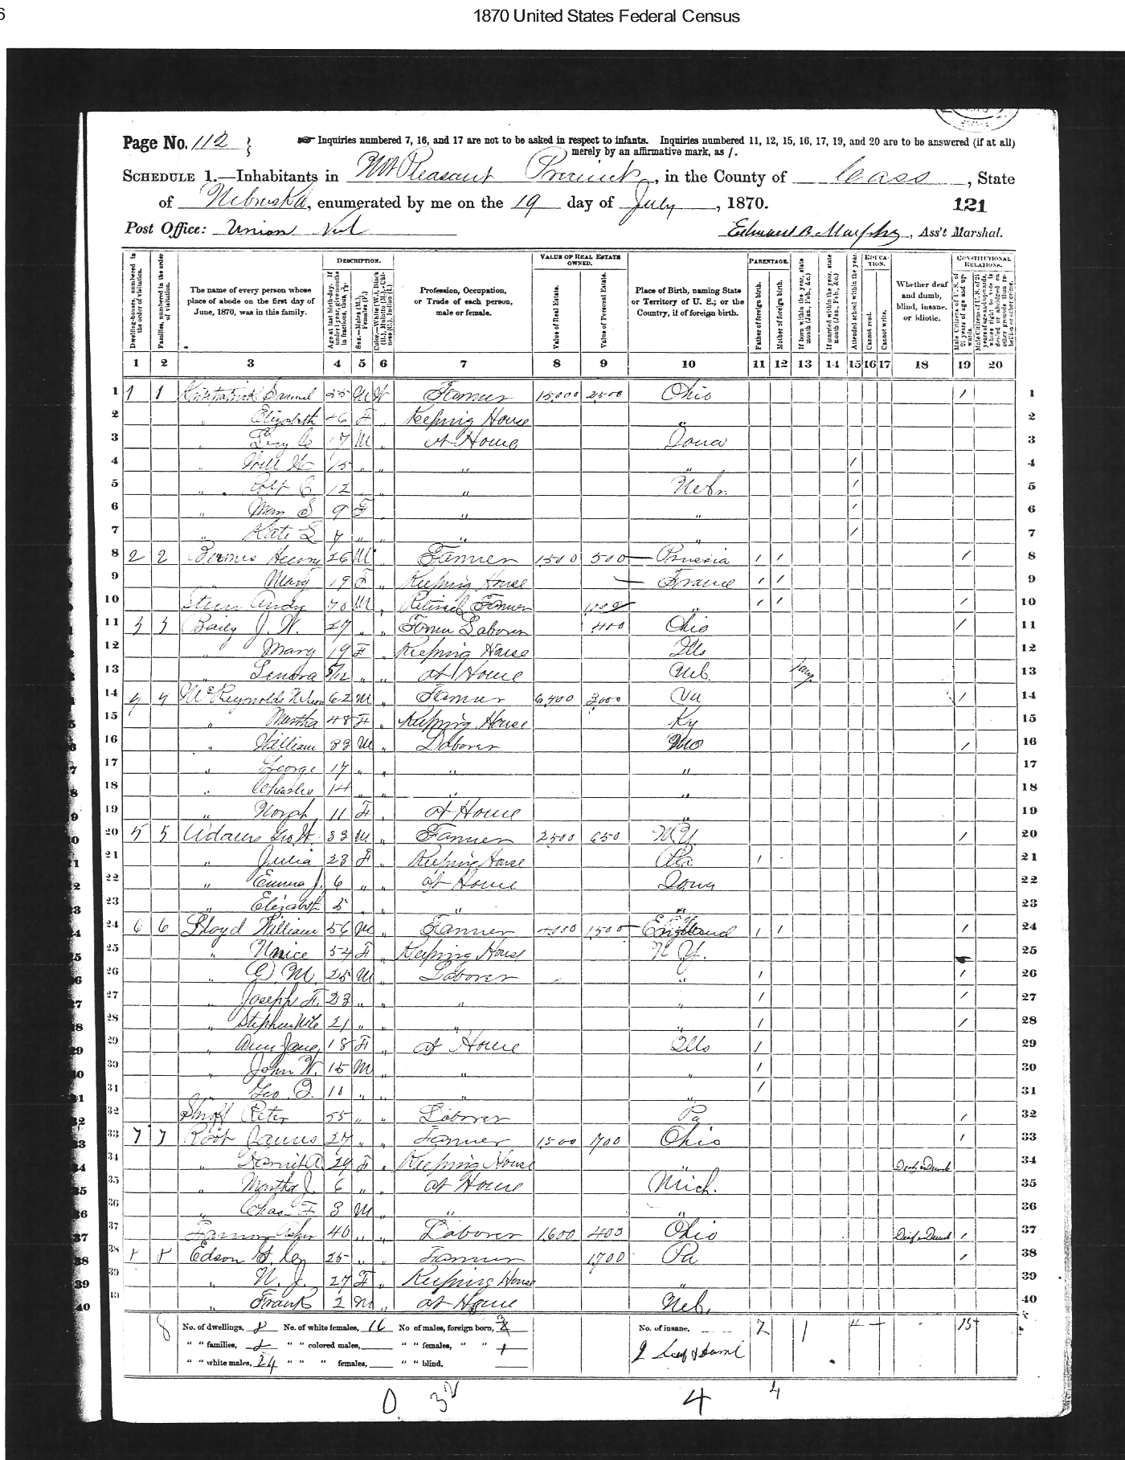
1870 US Census Mt Pleasant Twp
Cass County, NE
Andy Sturm
Age 70
Retired Farmer from France

Slide 39
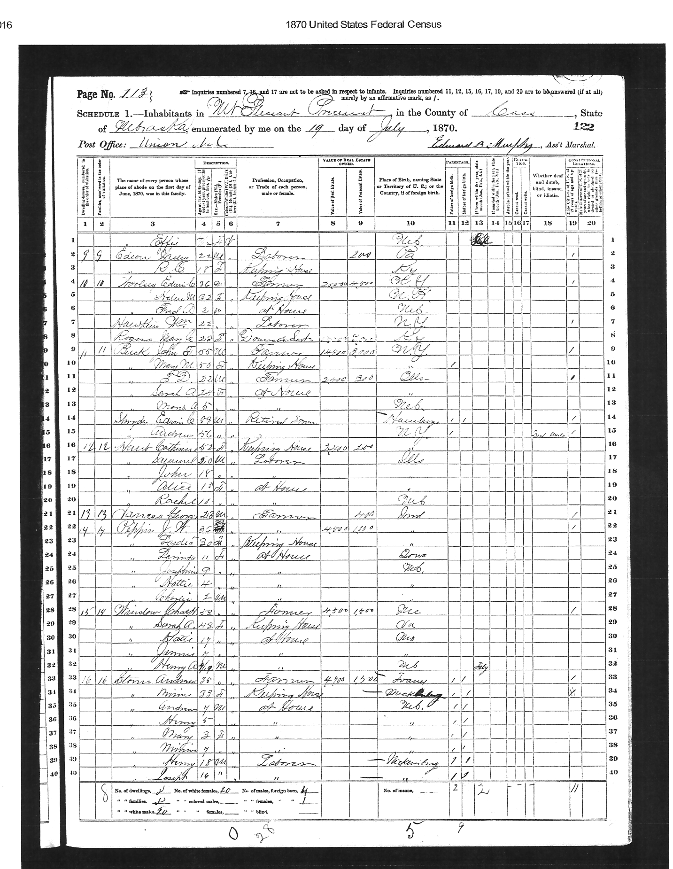
1870 US Census Mt Pleasant Twp
Cass County, NE
Andrew Sturm
Age 35
Farmer
From France

Slide 40
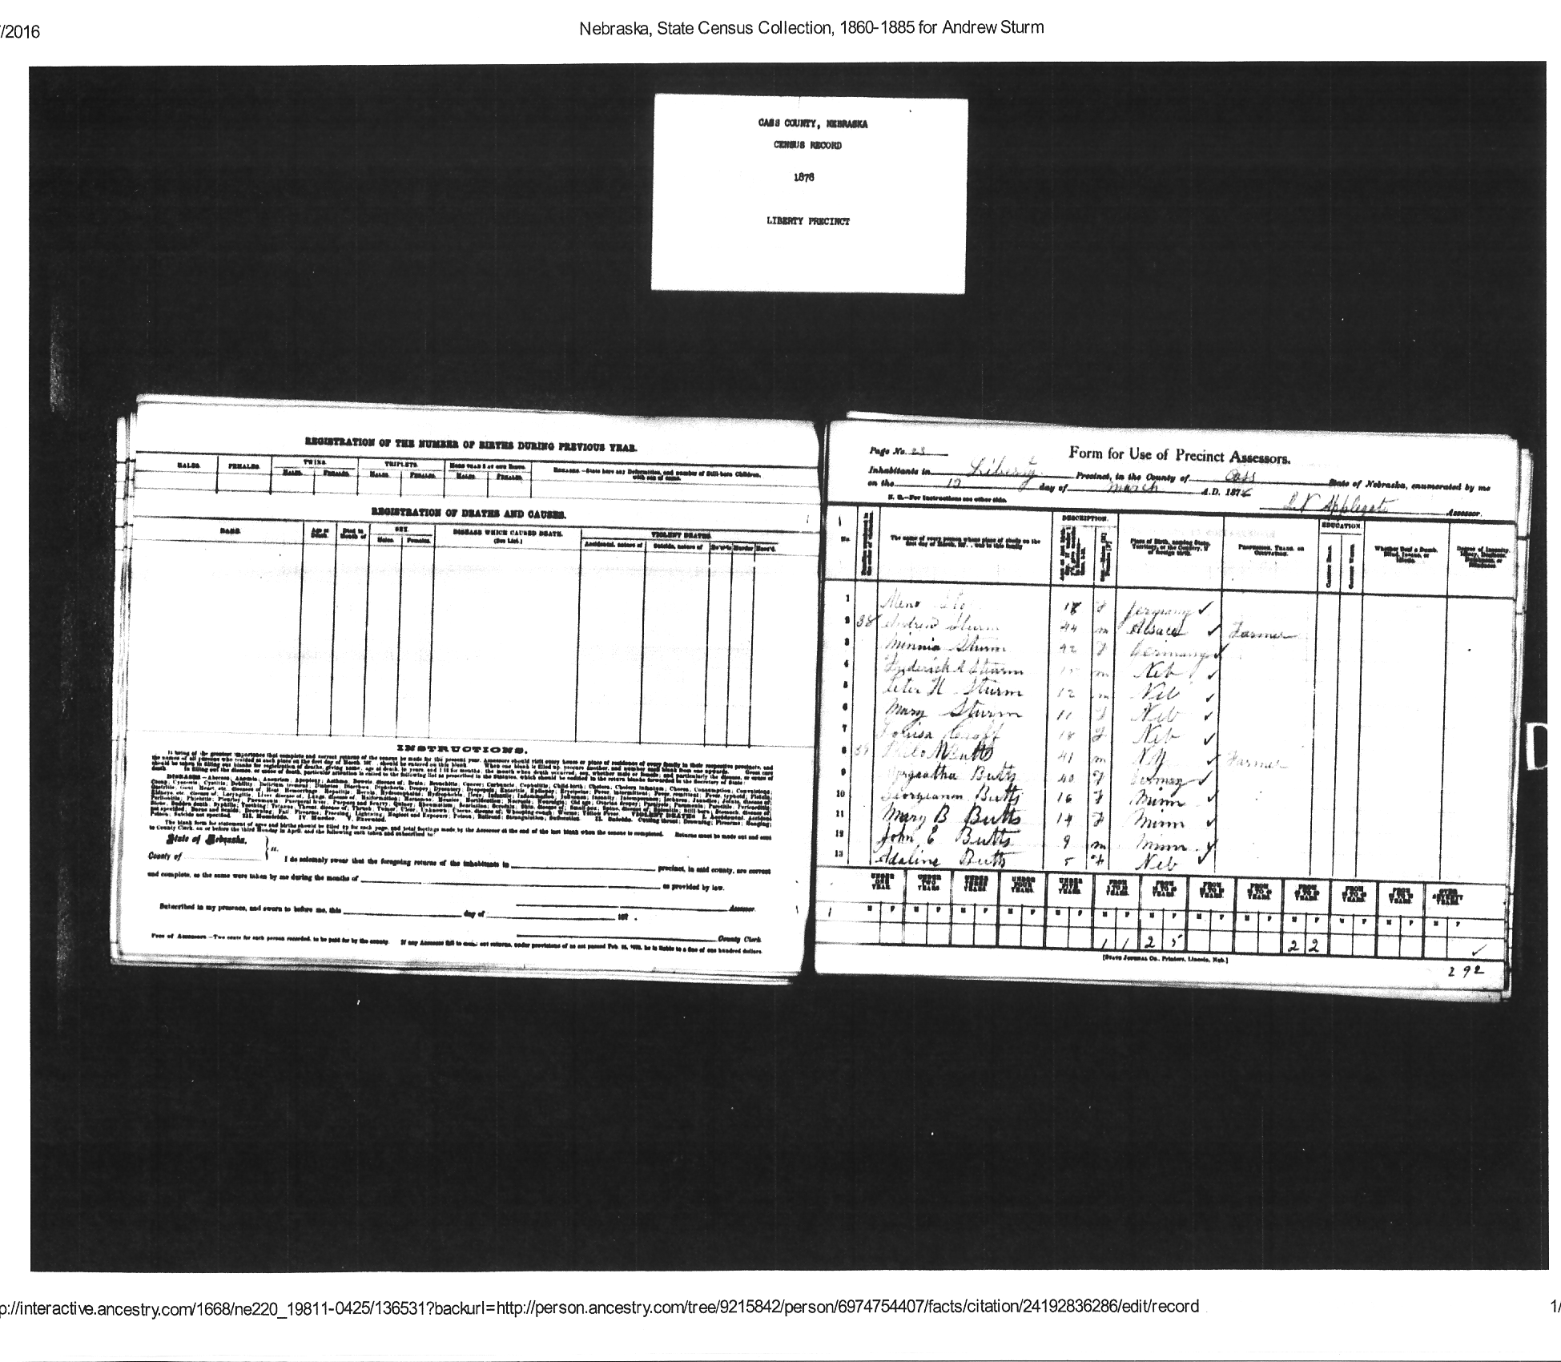
1878 Nebraska State Census
Andrew Sturm
& Family

Slide 41
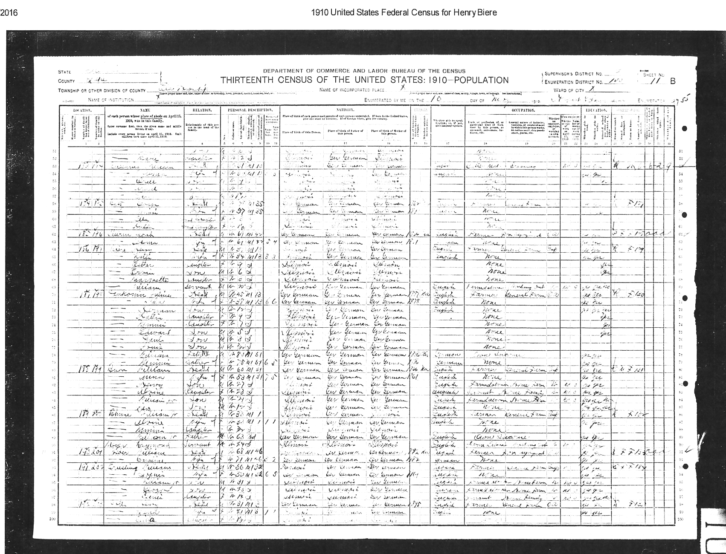
1910 US Census
Ervin Biere

